Slide 1
Understanding contraceptive discontinuation as part of sustainable mCPR growth
Evidence from the DRC DHS 2023–24 contraceptive calendar
Democratic Republic of the Congo • 26 provinces
1

Slide 2
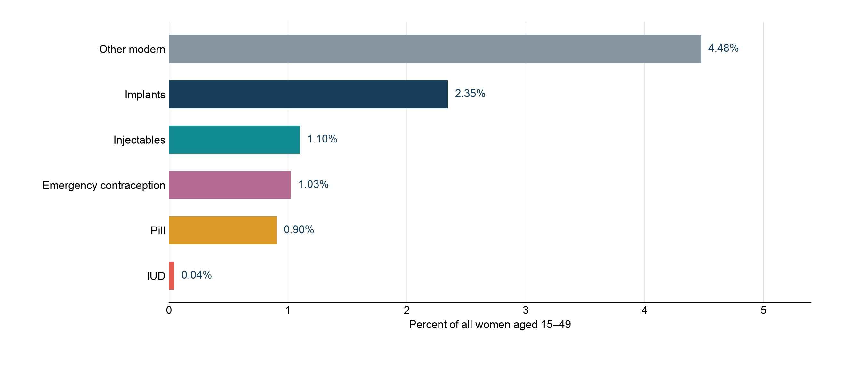
Modern contraceptive use in the DRC
9.9% of all women aged 15–49 report current modern-method use
Survey-weighted current use among all women; emergency contraception is included in the DHS modern-use classification.
2

Slide 3
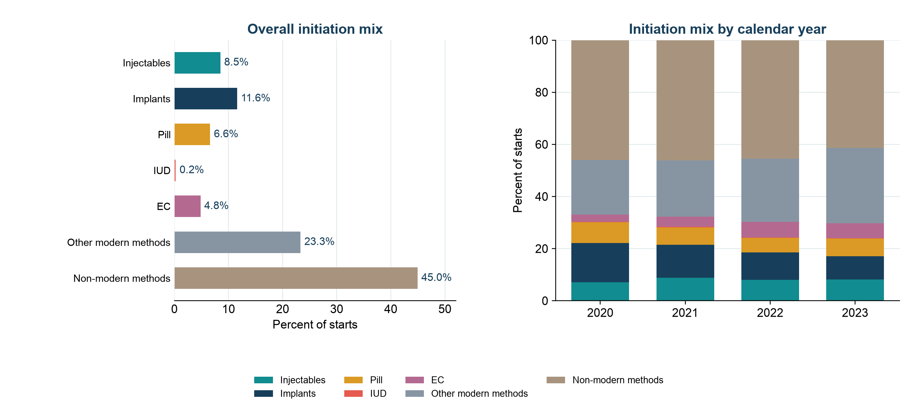
Entry methods set the denominator for future retention risk
Overall initiation mix and calendar-year changes
Shares use all observed contraceptive starts, including non-modern methods and emergency contraception.
3

Slide 4
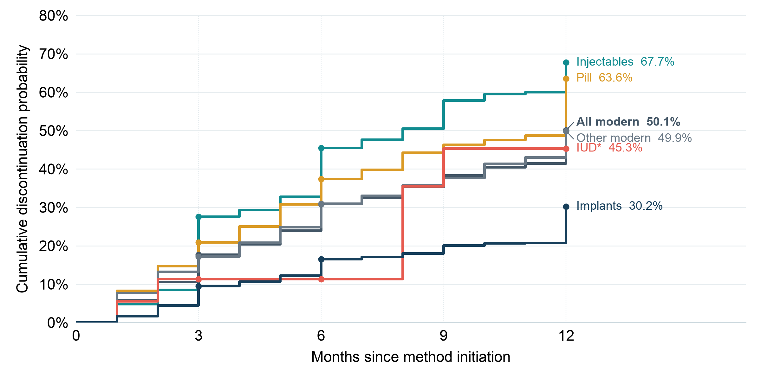
About half of modern-method episodes end within 12 months
Injectables and pills have the highest all-reason rates
All modern excludes emergency contraception. IUD is based on 23 eligible episodes and has limited precision.
4

Slide 5
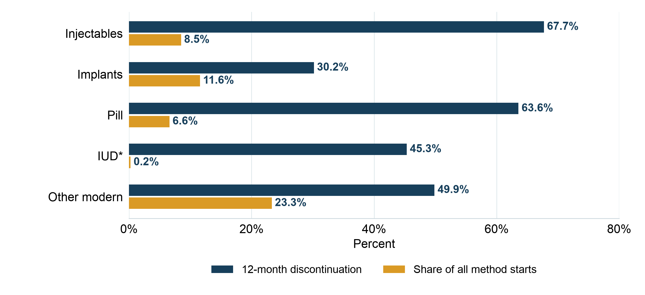
Starts and 12-month discontinuation vary by method
Share of all starts (gold) and all-reason discontinuation among episodes of each modern method (navy)
Start shares include non-modern methods in the denominator; IUD risk is sparse.
5

Slide 6
Understanding discontinuation reasons, risk factors, and regional differences
1
Reasons
2
Risk factors
3
Regions
Which reasons account for discontinuation and when do they emerge?
What factors are associated with a higher discontinuation rate?
Which regions have higher discontinuation rates and why?
6

Slide 7
Different reasons for discontinuation call for different responses
DRC all-reason framework
Potentially actionable
Method failure; wanting greater effectiveness; bleeding or other health effects; access, cost, or inconvenience.
Pregnancy intention
Stopping because the woman wanted to become pregnant is analyzed separately.
Partner and circumstances
Partner disapproval, other fertility-related reasons, and unresolved reasons remain competing endings.
7

Slide 8
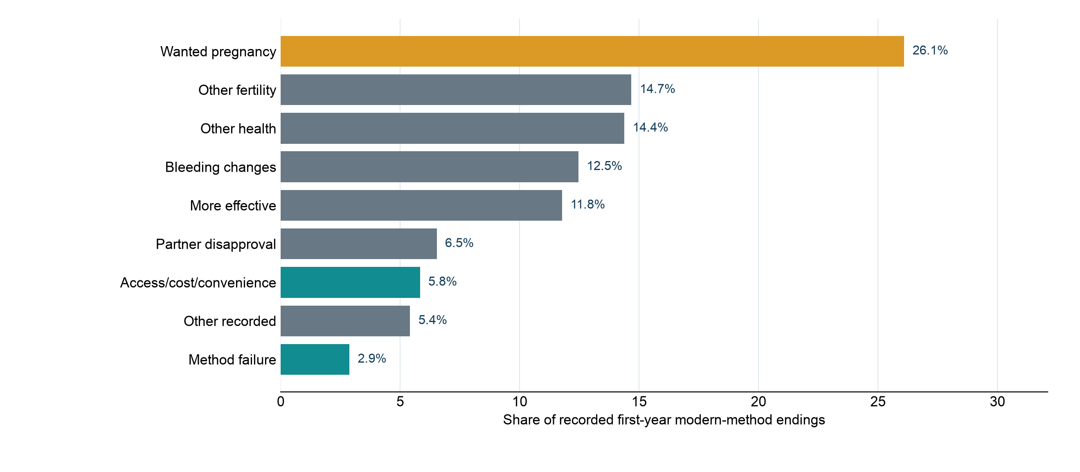
Pregnancy intention is the largest single recorded reason for ending modern use
Weighted distribution among recorded first-year modern-method endings
Other fertility includes infrequent sex or husband away, marital dissolution or separation, and difficulty becoming pregnant or menopause.
8

Slide 9
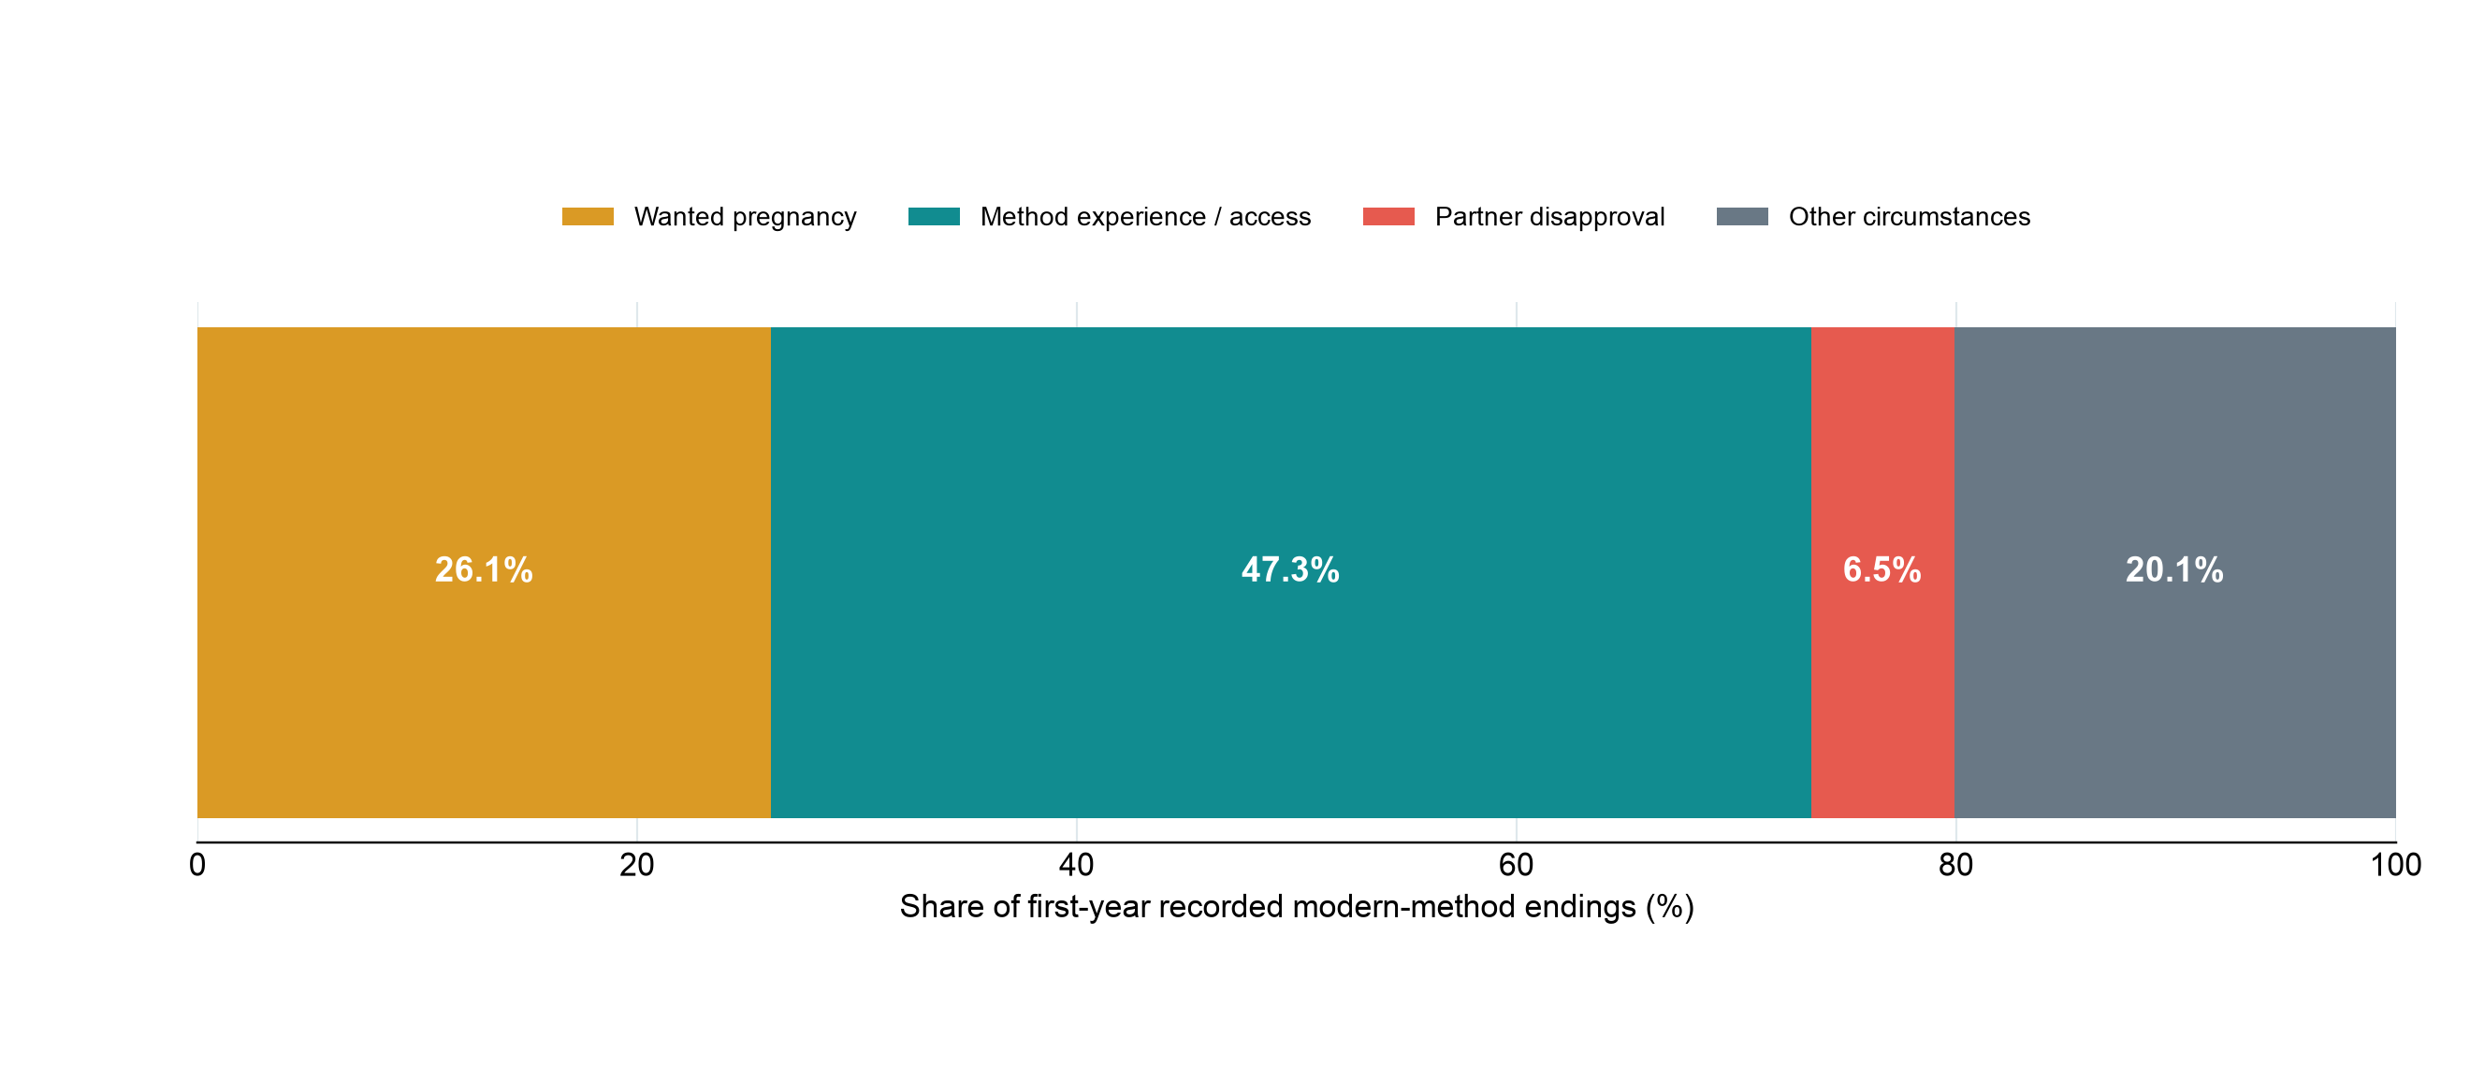
Method experience and access account for many modern-method endings
Share of recorded first-year modern-method endings
These shares describe reasons among endings; they are not 12-month risks among all episodes.
9

Slide 10
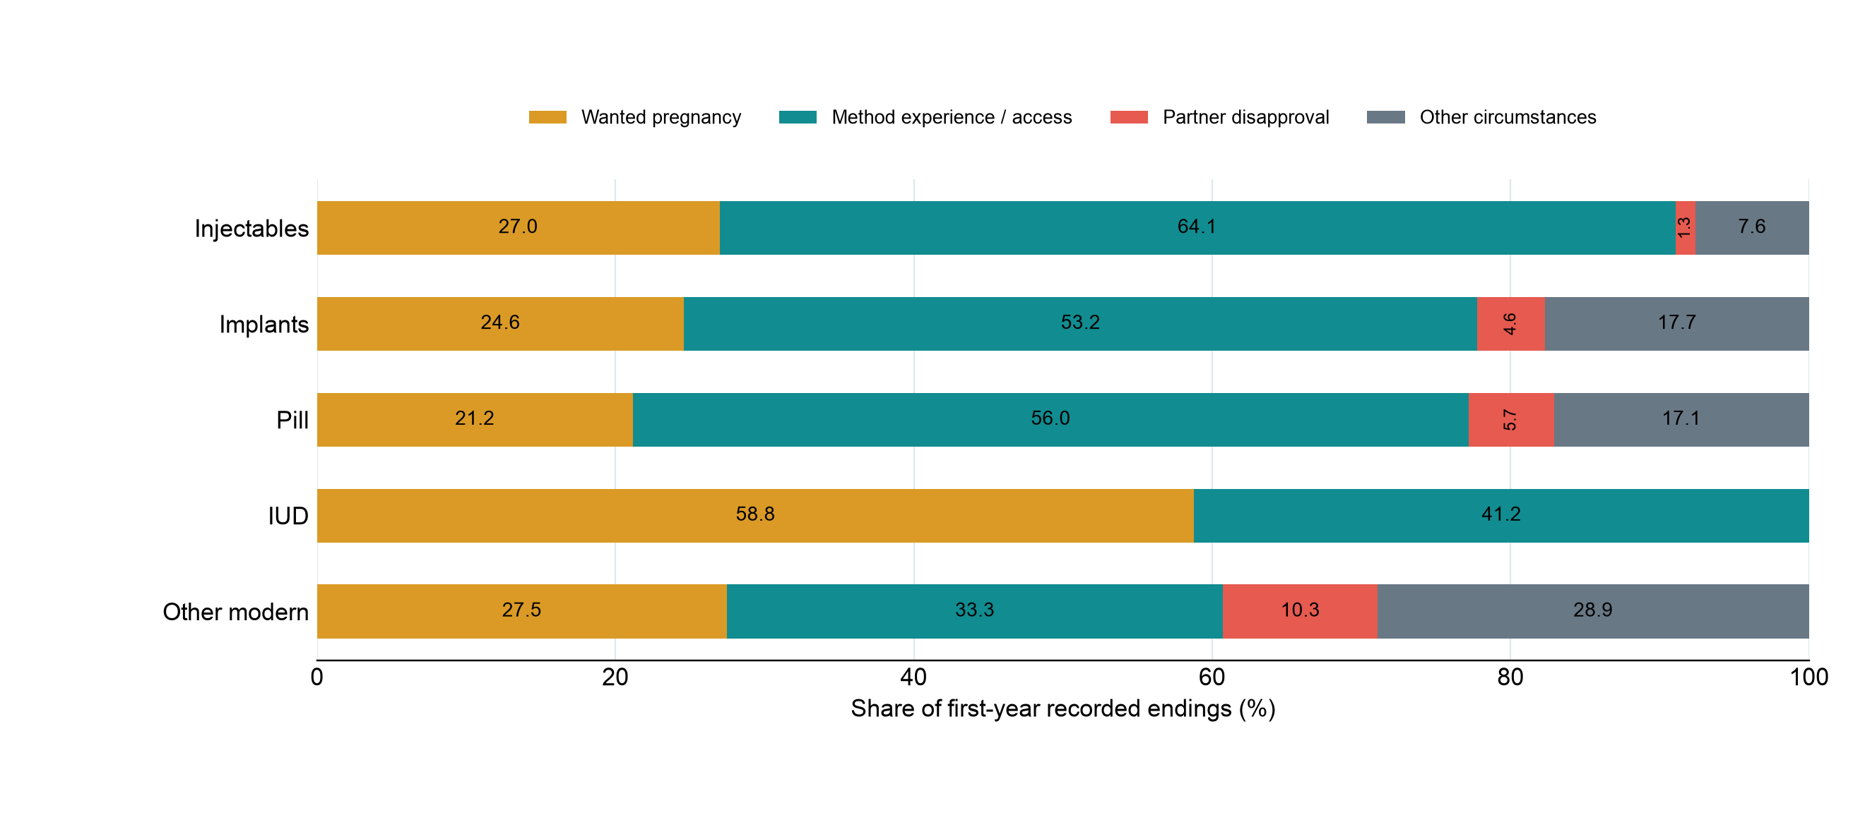
Reasons for discontinuation differ by modern method
Share of recorded first-year endings within each method
10

Slide 11
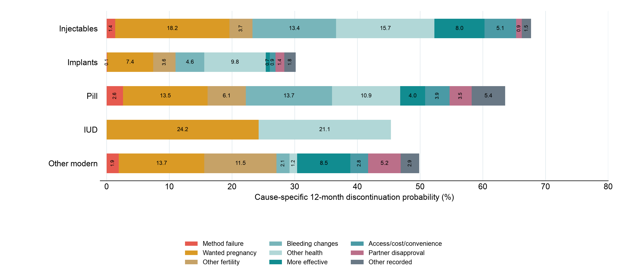
Cause-specific 12-month discontinuation differs by method
Competing-risk probabilities; colored segments sum to each method’s all-reason rate
The IUD row is imprecise because only 23 eligible episodes were observed.
11

Slide 12
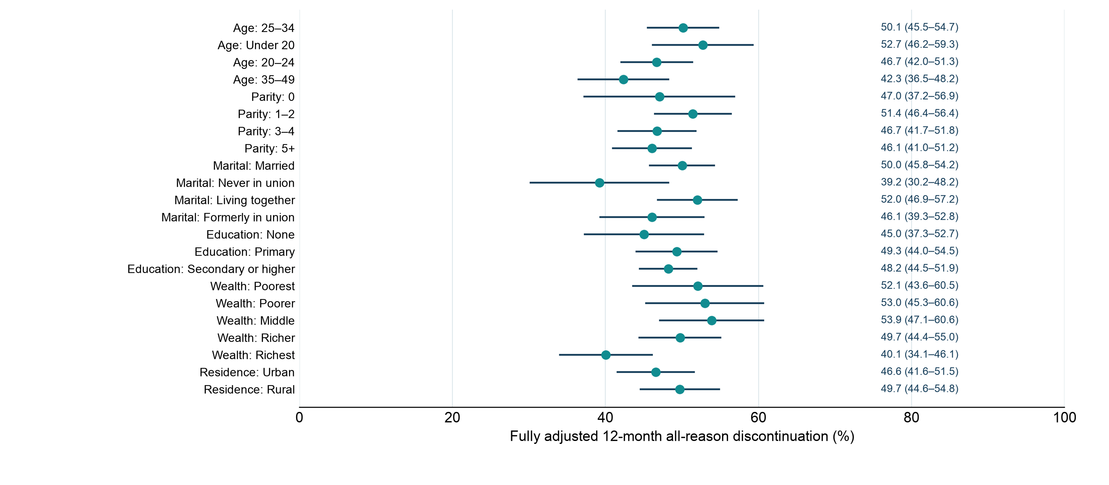
Who is more likely to discontinue a modern method?
Fully adjusted 12-month all-reason probabilities by subgroup
Survey-design discrete-time model adjusts for method, province, month of use, age, parity, marital status, education, wealth, residence, and start year.
12

Slide 13
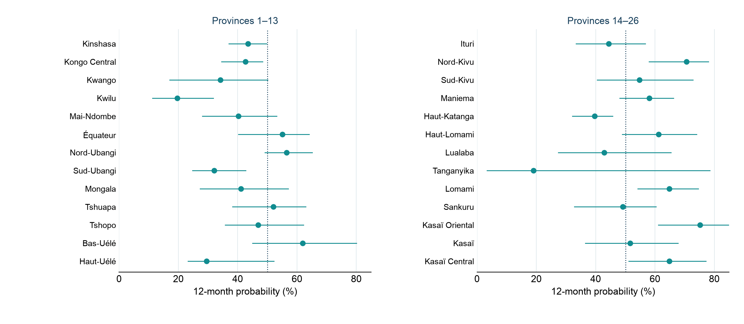
All-reason discontinuation varies across the DRC’s 26 provinces
Observed 12-month probabilities with survey-bootstrap confidence intervals
All modern methods excluding emergency contraception; several provinces have wide intervals.
13

Slide 14
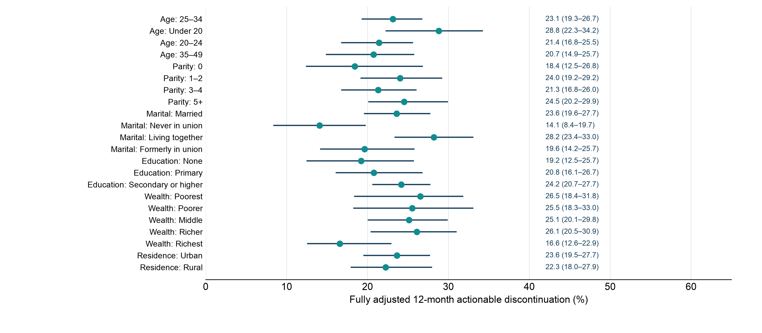
Who is more likely to stop a modern method for an actionable reason?
Fully adjusted 12-month probabilities by subgroup
Survey-stratified PSU-bootstrap intervals; the competing-risk model adjusts for method, province, month of use, age, parity, marital status, education, wealth, residence, and start year.
14

Slide 15
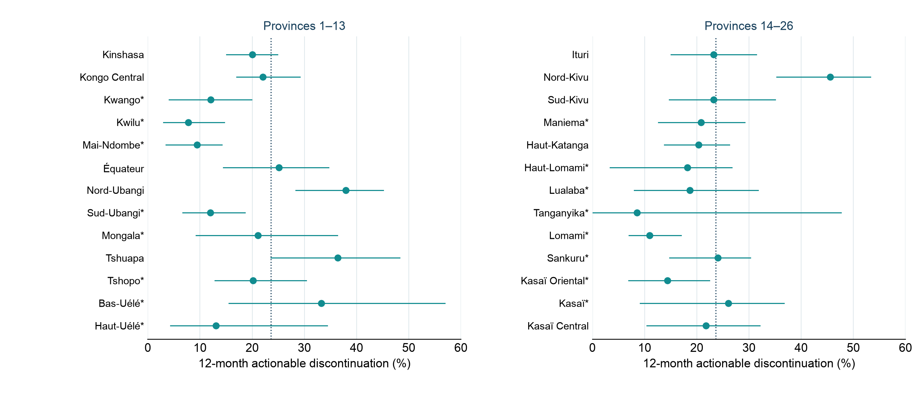
Actionable discontinuation varies across the DRC’s 26 provinces
Observed 12-month probabilities with survey-design confidence intervals
All modern methods excluding EC. * Fewer than 30 observed actionable endings; interpret these provincial estimates cautiously.
15

Slide 16
Why do regions differ in contraceptive discontinuation?
01
02
03
Measure regional
variation
Explain regional
gaps
Link service
context
Where is risk high and
the burden large?
Do different users and
methods explain the gap?
Which conditions track
the remaining gaps?
Compare discontinuation,
modern-use exits, and mCPR.
Use adjusted survival models
and Oaxaca–Blinder
decomposition to assess how
method mix and differences
in characteristics such as age,
parity, and wealth, among
others, explain regional gaps.
Use multilevel survival
models linked to service data
to examine associations with
supply, access, counseling,
and support for switching.
16

Slide 17
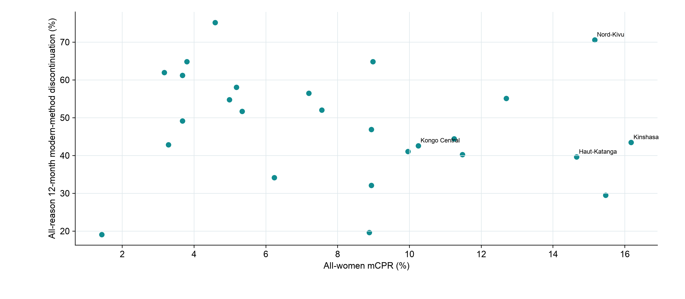
mCPR and discontinuation provide different provincial signals
All-women mCPR versus all-reason 12-month modern-method discontinuation
The two measures have different denominators and should be used together for program planning.
17

Slide 18
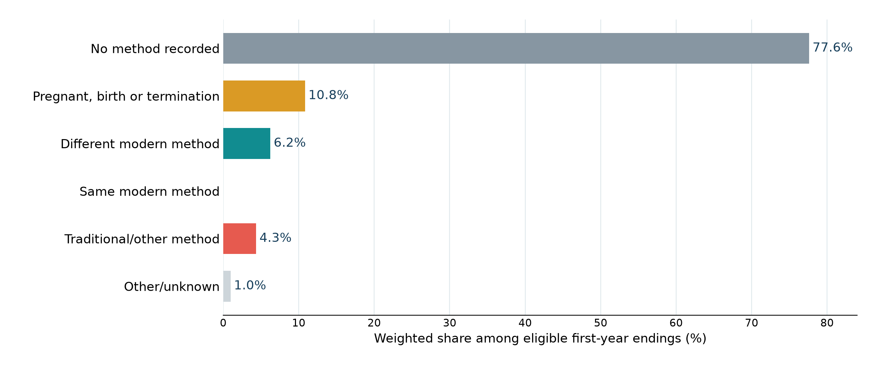
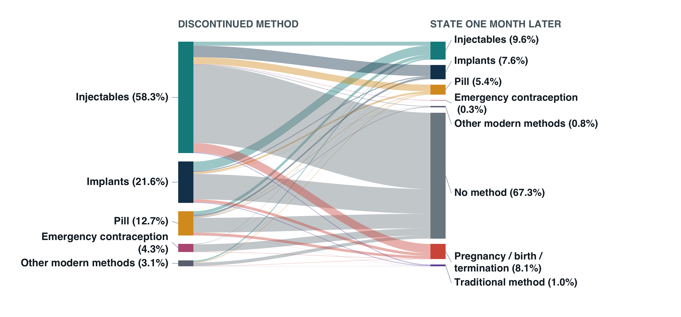
Many women are not using a modern method one month after ending one
Modern-method status one month after a selected-reason ending
Selected reasons exclude wanted pregnancy and partner disapproval; the chart is weighted among eligible endings.
18

Slide 19
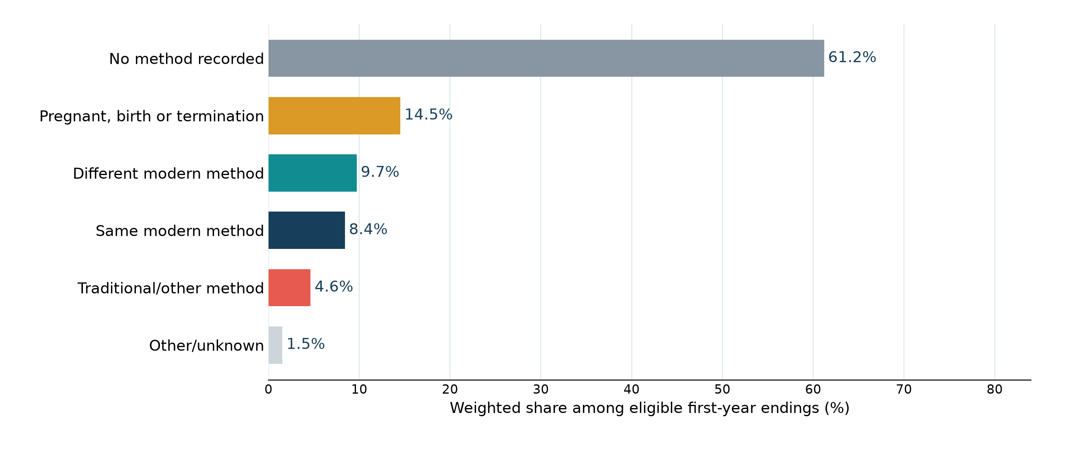
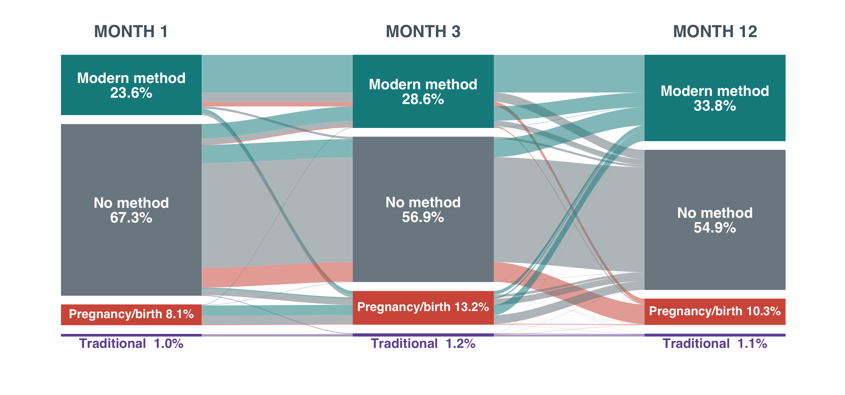
Modern use can resume after discontinuation, but nonuse persists
Modern-method status 12 months after a selected-reason ending
Selected reasons exclude wanted pregnancy and partner disapproval; this is a descriptive follow-up cohort.
19

Slide 20
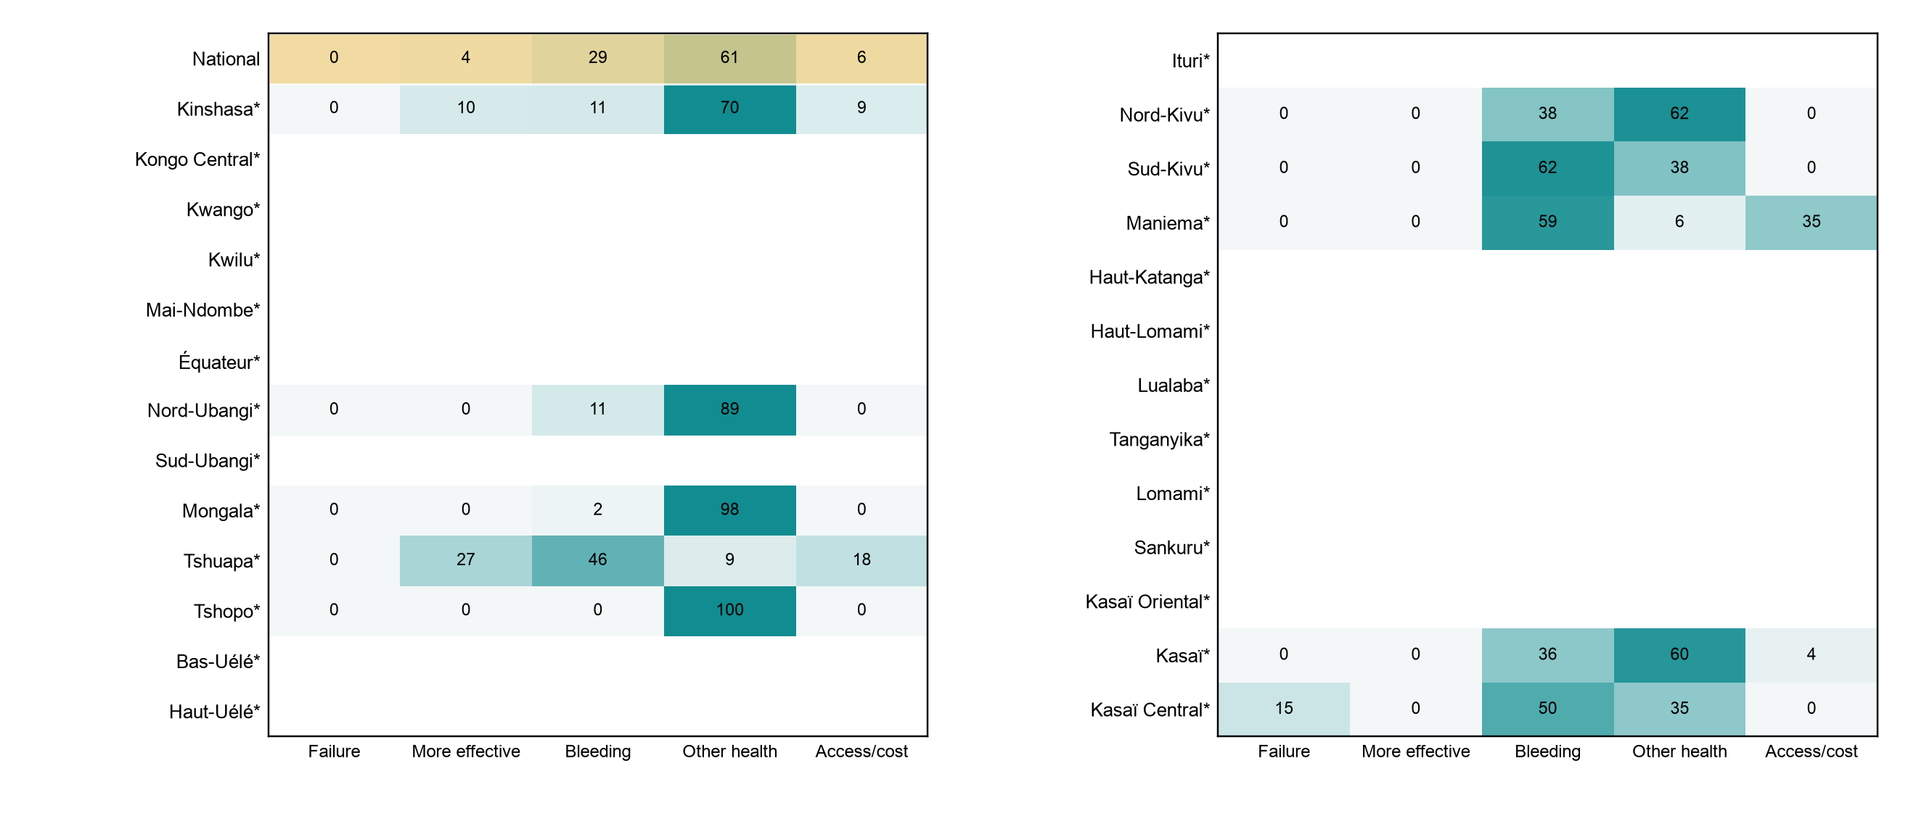
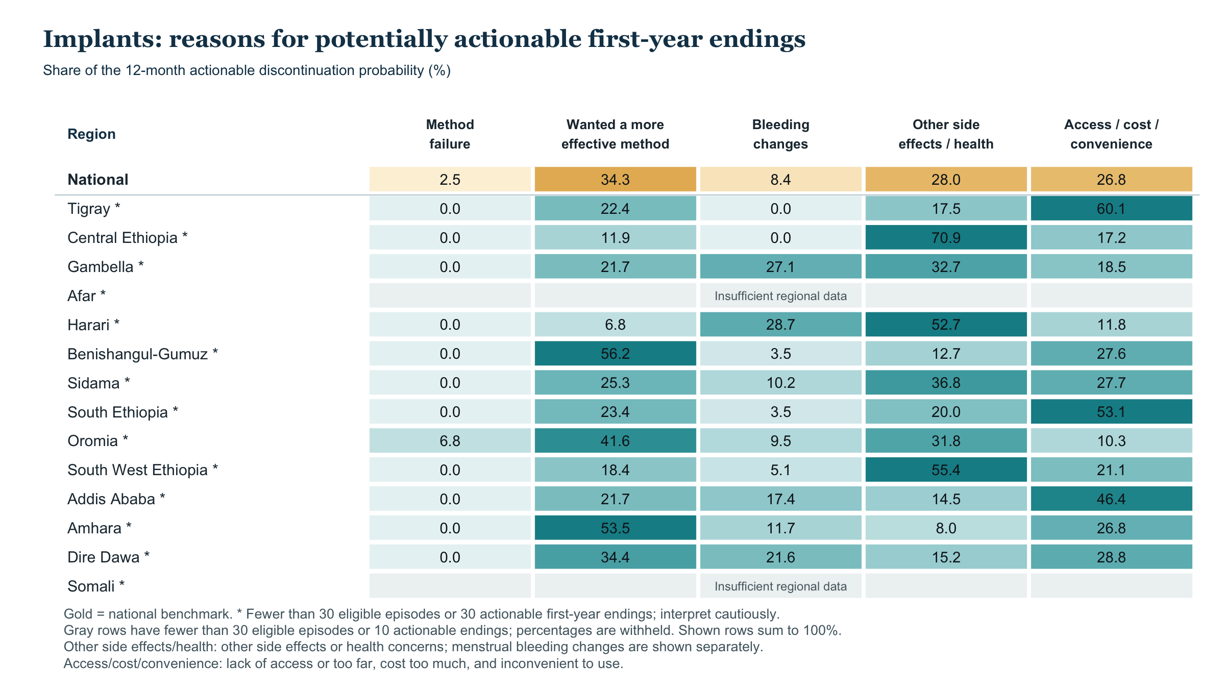
Implants: reasons for actionable first-year endings
Shares among this method’s actionable first-year endings in each province
Province rows with fewer than five endings are blank; * marks fewer than 30 actionable endings. Displayed rows sum to 100 before rounding.
20

Slide 21
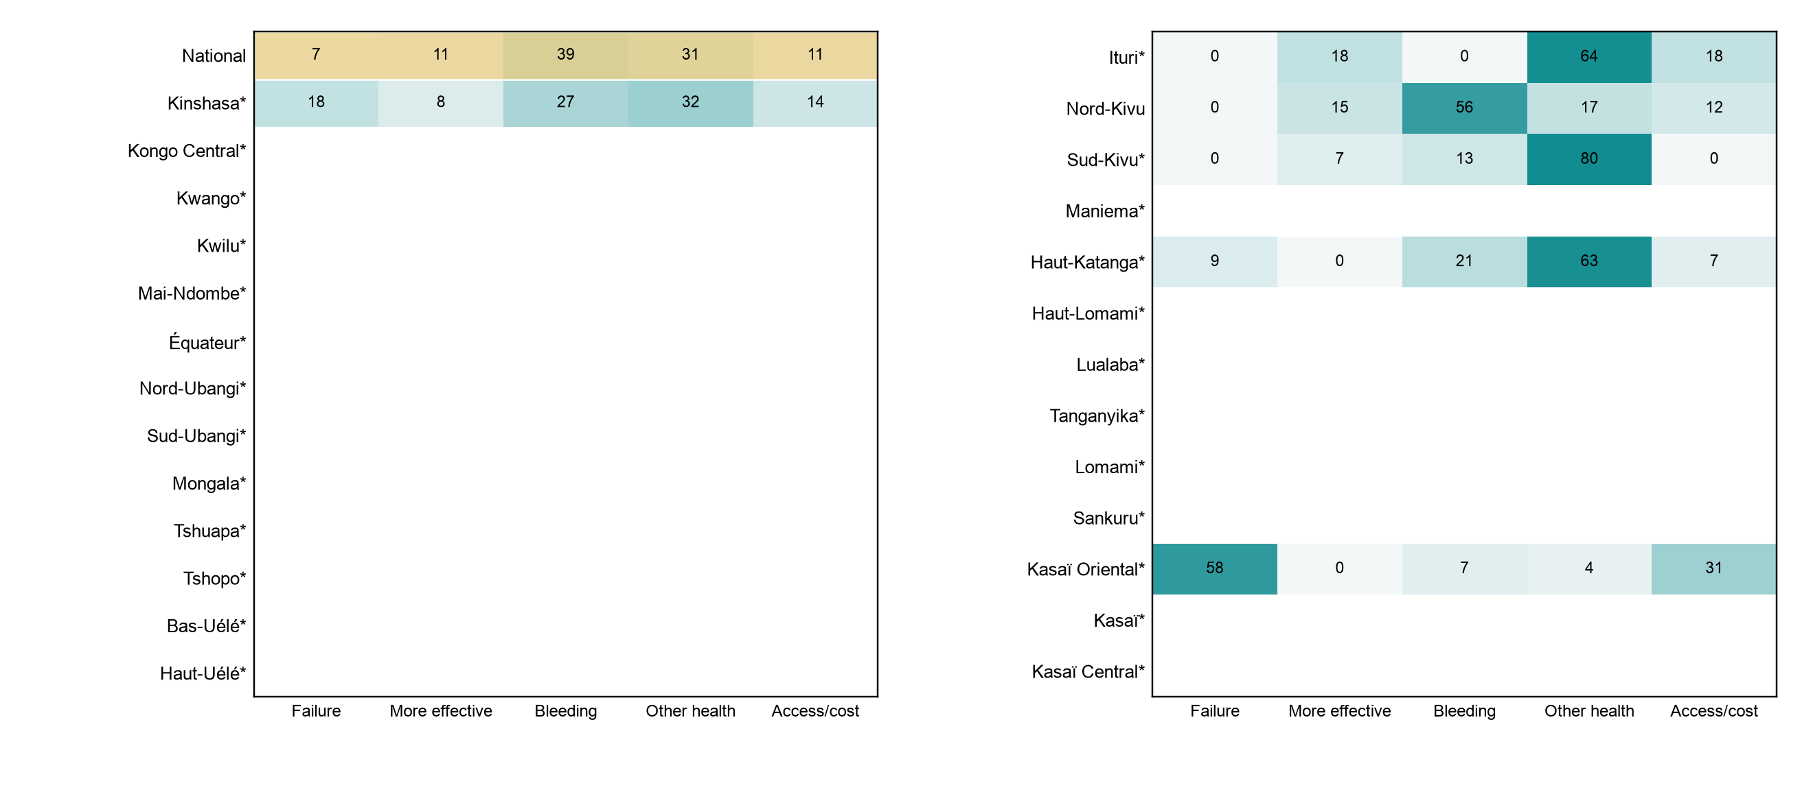
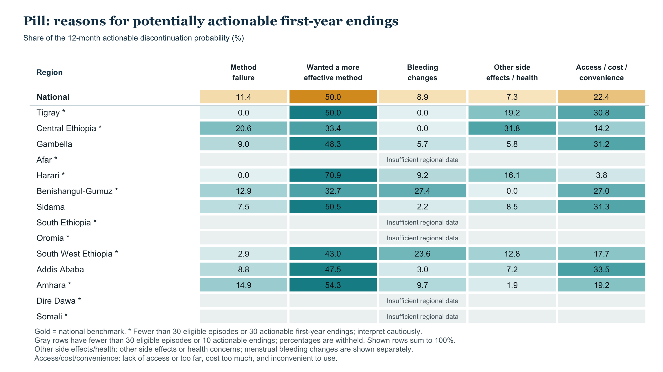
Pill: reasons for actionable first-year endings
Shares among this method’s actionable first-year endings in each province
Province rows with fewer than five endings are blank; * marks fewer than 30 actionable endings. Displayed rows sum to 100 before rounding.
21

Slide 22
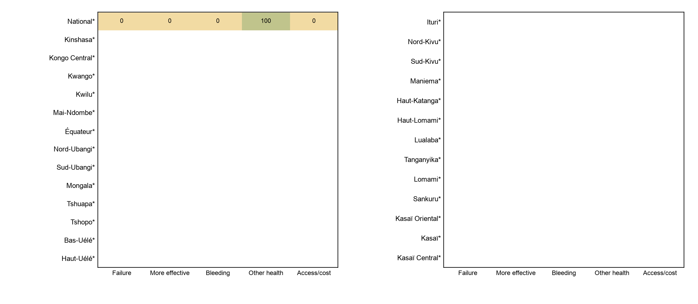
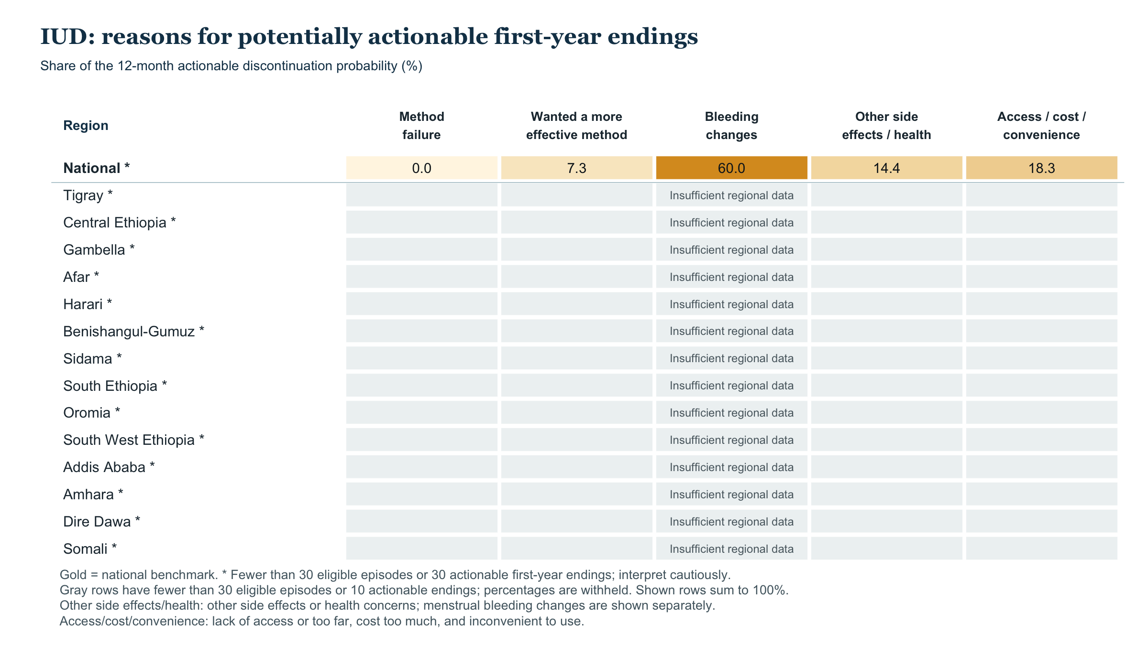
IUD: reasons for actionable first-year endings
Shares among this method’s actionable first-year endings in each province
Province rows with fewer than five endings are blank; * marks fewer than 30 actionable endings. Displayed rows sum to 100 before rounding.
22

Slide 23
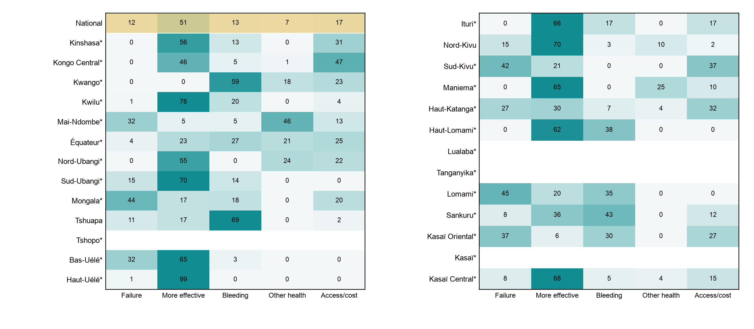
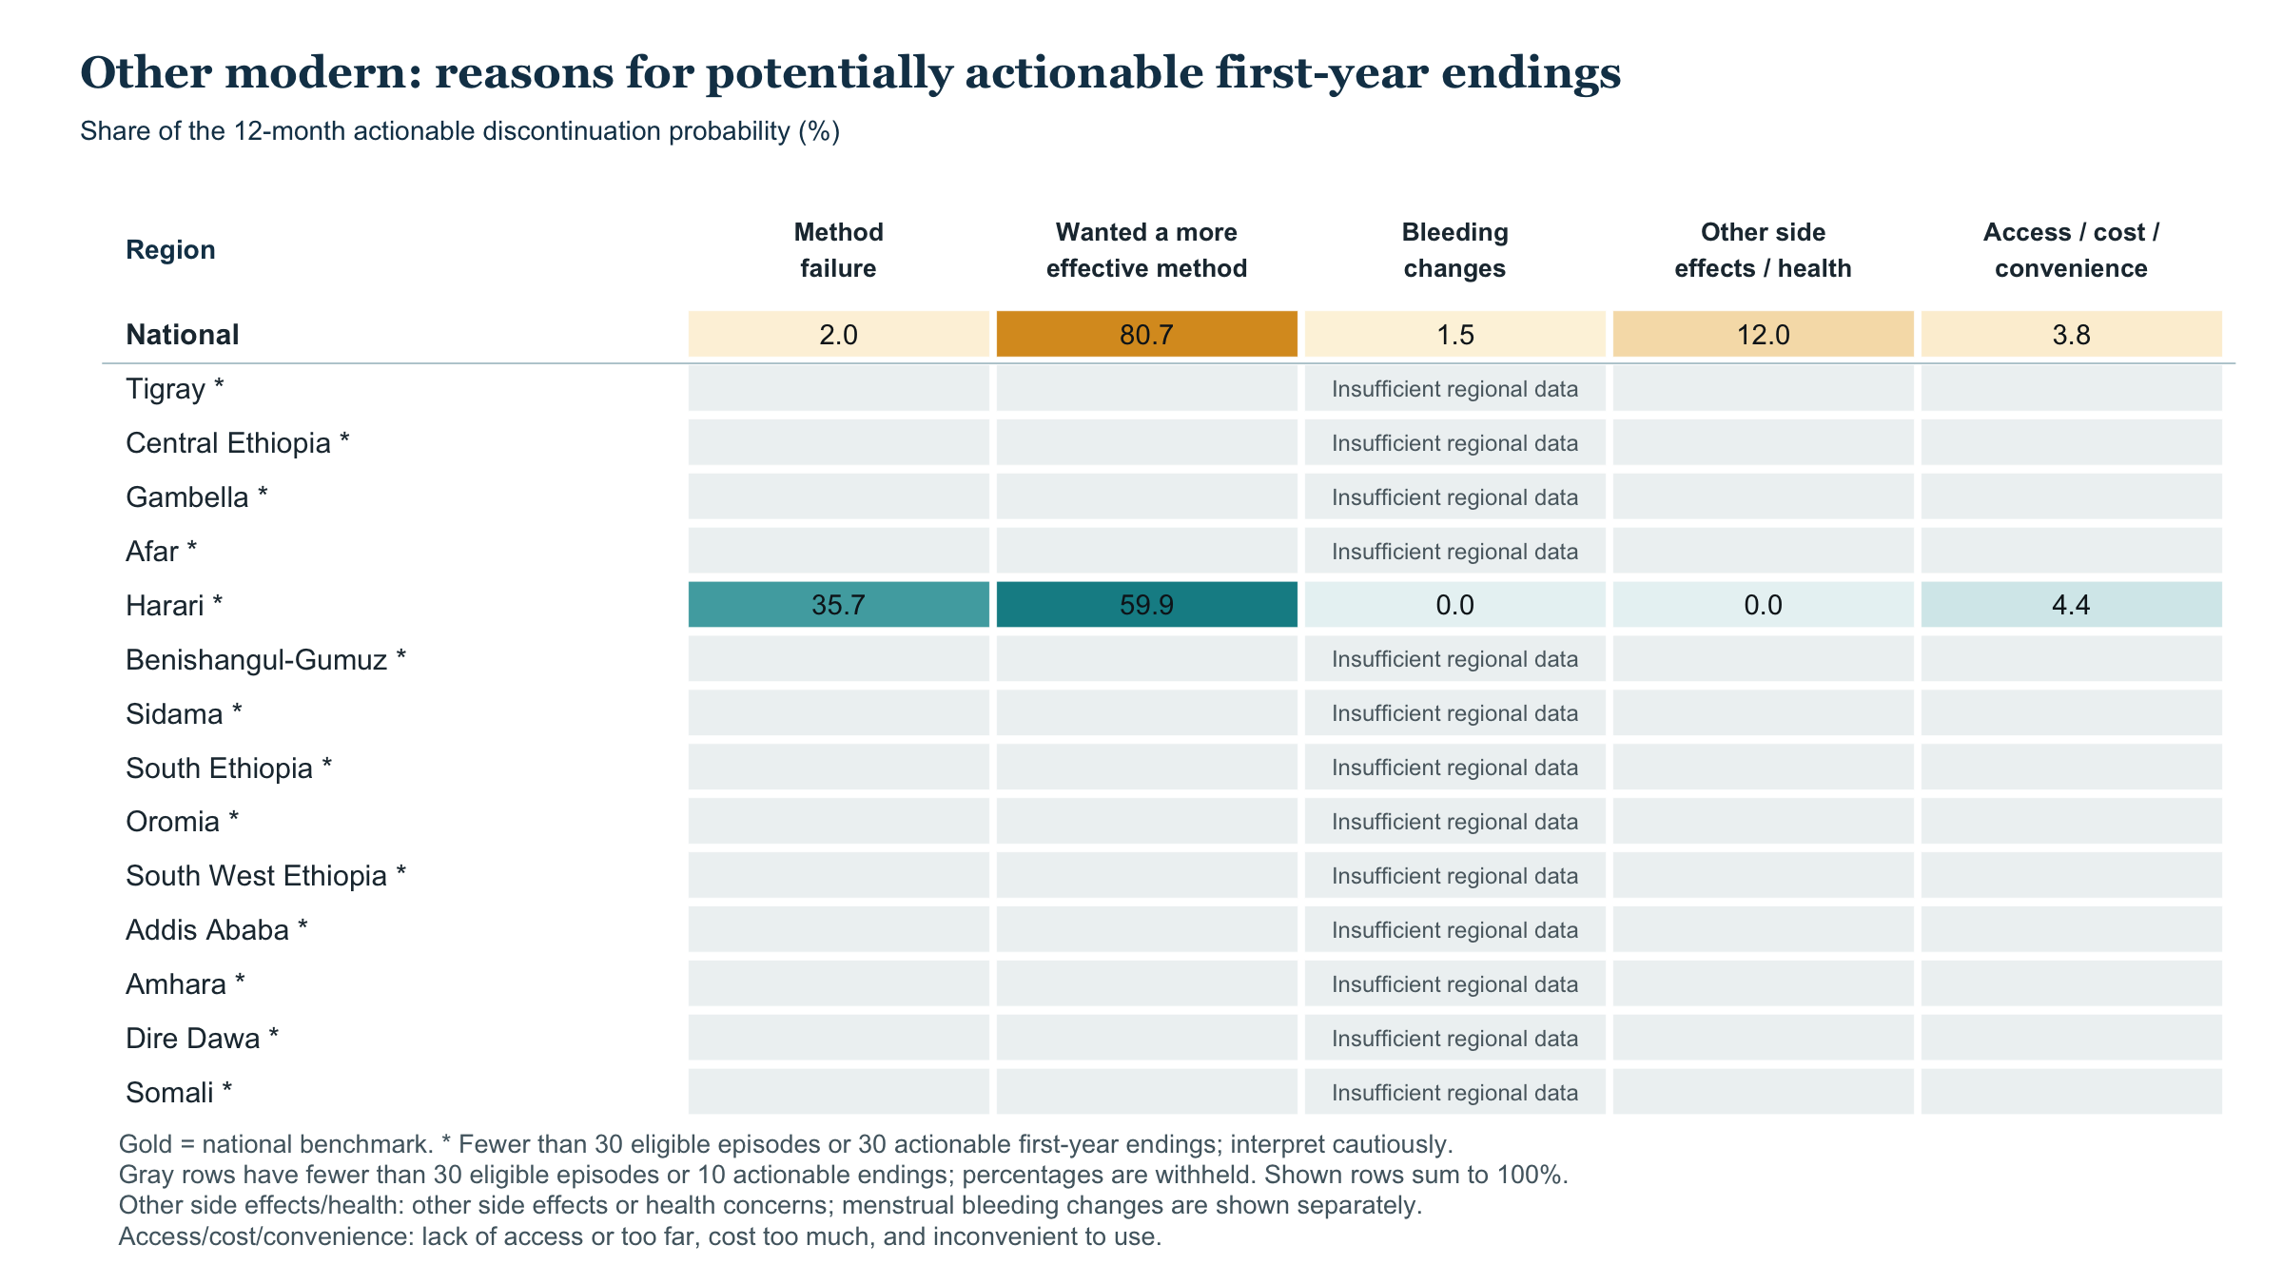
Other modern: reasons for actionable first-year endings
Shares among this method’s actionable first-year endings in each province
Province rows with fewer than five endings are blank; * marks fewer than 30 actionable endings. Displayed rows sum to 100 before rounding.
23

Slide 24
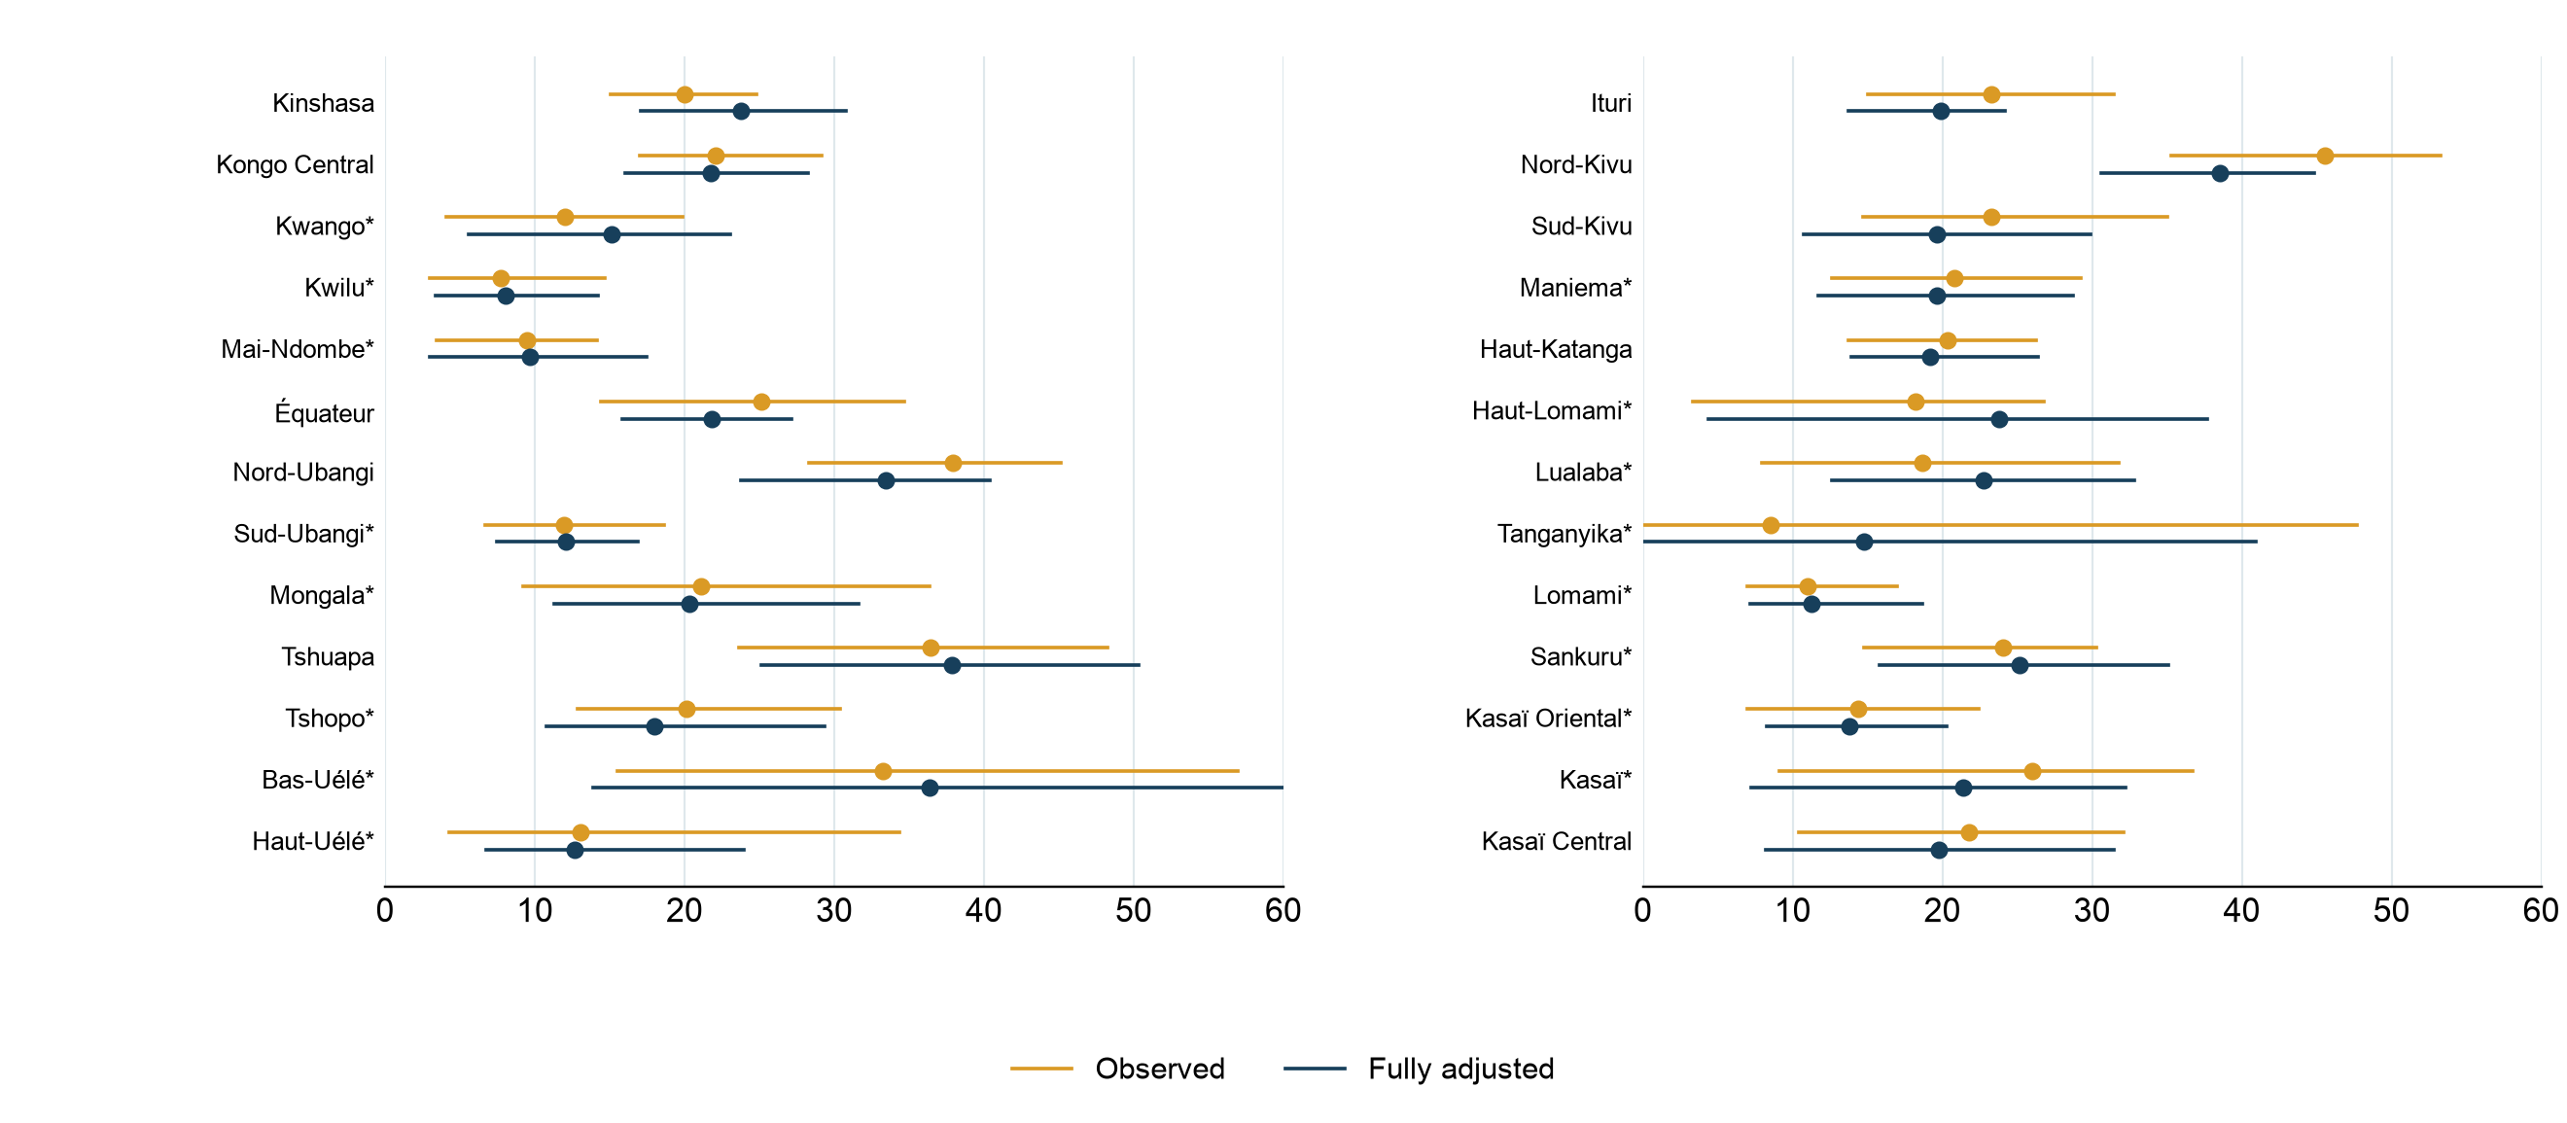
Observed and adjusted actionable discontinuation across provinces
12-month probability with 95% intervals; gold observed, navy fully adjusted
Full model adjusts for method, use month, province, age, parity, marital status, education, wealth, residence, and start year. * Sparse actionable cell.
24

Slide 25
Provincial actionable discontinuation probabilities
12-month percentage; 95% intervals in parentheses
Province | Episodes | Observed | Method + month | Fully adjusted
National | 4146 | 23.6% (20.7–26.7) | 23.3% (20.6–26.1) | 22.9% (20.0–25.9)
Kinshasa | 368 | 20.0% (15.0–24.8) | 19.5% (14.8–24.8) | 23.7% (17.1–30.8)
Kongo Central | 194 | 22.1% (17.0–29.2) | 23.3% (19.0–29.5) | 21.8% (16.1–28.2)
Kwango* | 68 | 12.0% (4.1–19.9) | 16.8% (6.7–25.7) | 15.1% (5.6–23.0)
Kwilu* | 122 | 7.7% (3.0–14.7) | 9.7% (3.7–16.8) | 8.1% (3.4–14.2)
Mai-Ndombe* | 181 | 9.5% (3.4–14.2) | 11.4% (4.1–17.6) | 9.7% (3.0–17.5)
Équateur | 256 | 25.1% (14.4–34.6) | 25.6% (18.8–31.0) | 21.8% (15.9–27.2)
Nord-Ubangi | 129 | 37.9% (28.3–45.1) | 37.6% (27.2–43.9) | 33.4% (23.8–40.4)
Sud-Ubangi* | 169 | 12.0% (6.7–18.6) | 13.5% (8.9–17.7) | 12.1% (7.5–16.9)
Mongala* | 145 | 21.1% (9.2–36.4) | 24.1% (12.6–34.5) | 20.3% (11.3–31.6)
Tshuapa | 162 | 36.4% (23.6–48.2) | 43.7% (30.3–54.2) | 37.9% (25.1–50.3)
Tshopo* | 114 | 20.1% (12.9–30.4) | 20.4% (12.7–31.9) | 18.0% (10.8–29.3)
Bas-Uélé* | 44 | 33.3% (15.5–56.9) | 41.5% (20.2–67.9) | 36.4% (13.9–65.1)
Haut-Uélé* | 94 | 13.0% (4.3–34.4) | 12.4% (6.5–24.5) | 12.7% (6.8–24.0)
Adjusted rates are predicted on a common observed-start profile. * Fewer than 30 observed actionable endings.
25

Slide 26
Provincial actionable discontinuation probabilities (continued)
12-month percentage; 95% intervals in parentheses
Province | Episodes | Observed | Method + month | Fully adjusted
Ituri | 203 | 23.3% (15.0–31.4) | 21.1% (15.2–25.5) | 19.9% (13.7–24.2)
Nord-Kivu | 378 | 45.5% (35.3–53.3) | 41.3% (32.3–48.2) | 38.5% (30.6–44.8)
Sud-Kivu | 193 | 23.3% (14.7–35.0) | 20.2% (12.3–31.8) | 19.6% (10.7–29.9)
Maniema* | 129 | 20.8% (12.6–29.2) | 23.2% (15.1–32.5) | 19.7% (11.7–28.7)
Haut-Katanga | 305 | 20.3% (13.7–26.3) | 17.5% (11.5–23.2) | 19.2% (13.9–26.4)
Haut-Lomami* | 73 | 18.2% (3.4–26.8) | 22.8% (4.6–32.5) | 23.8% (4.3–37.7)
Lualaba* | 73 | 18.7% (8.0–31.8) | 23.0% (11.6–32.0) | 22.7% (12.6–32.8)
Tanganyika* | 16 | 8.5% (0.0–47.7) | 15.2% (0.0–41.2) | 14.8% (0.0–40.9)
Lomami* | 121 | 11.0% (7.0–17.0) | 12.8% (7.7–19.5) | 11.2% (7.1–18.7)
Sankuru* | 58 | 24.0% (14.8–30.3) | 28.1% (19.4–35.4) | 25.1% (15.8–35.1)
Kasaï Oriental* | 188 | 14.4% (7.0–22.4) | 16.4% (9.1–22.9) | 13.8% (8.3–20.3)
Kasaï* | 87 | 26.0% (9.1–36.7) | 21.6% (7.5–32.5) | 21.4% (7.2–32.2)
Kasaï Central | 276 | 21.8% (10.4–32.1) | 21.8% (10.1–31.7) | 19.7% (8.2–31.5)
Adjusted rates are predicted on a common observed-start profile. * Fewer than 30 observed actionable endings.
26

Slide 27
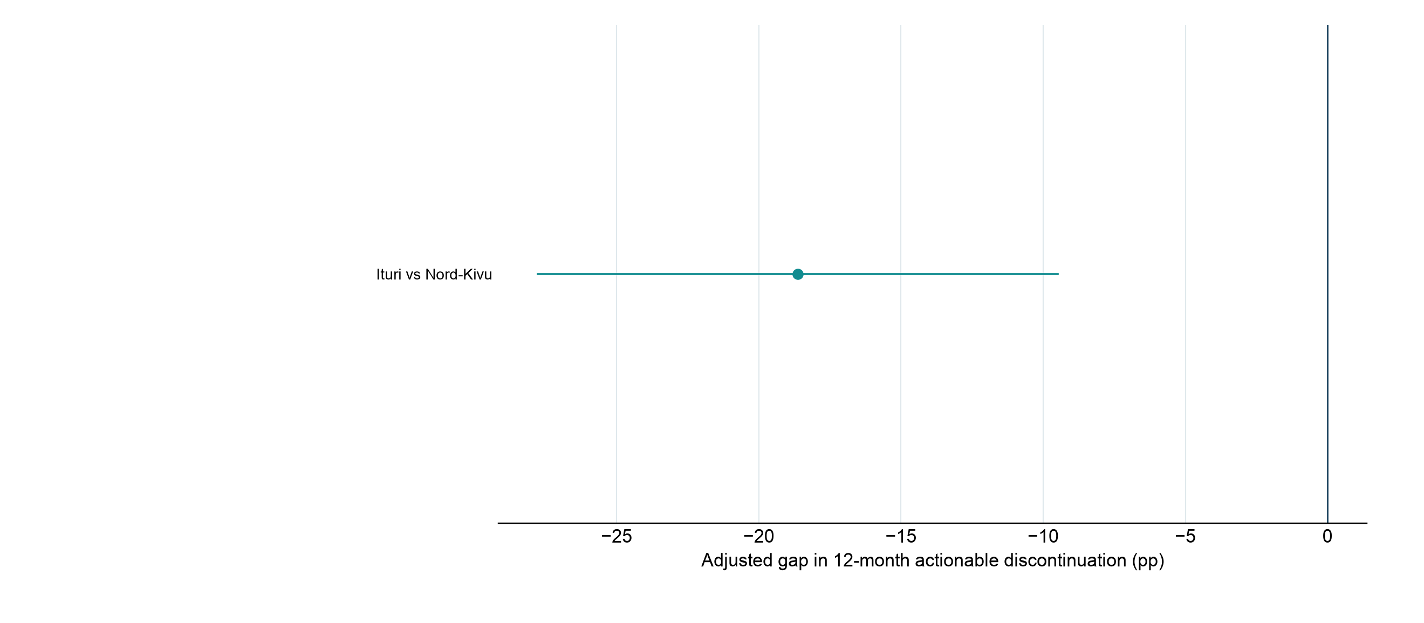
Fully adjusted province gaps that survive pairwise correction
Holm-corrected tests across 325 pairs; only nonsparse significant pairs shown
Differences and intervals derive from 120 survey-stratified PSU-bootstrap model refits; omitted sparse pairs are not evidence of equality.
27

Slide 28
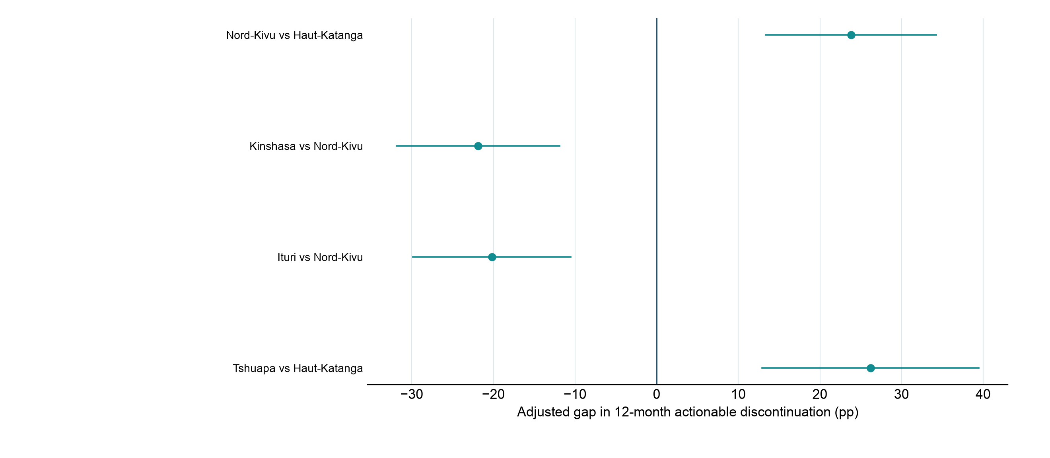
Provincial gaps after accounting for method mix
Holm-corrected tests from the method-and-month model; only nonsparse significant pairs shown
Each province is compared on a common observed-start method profile; 325 pairwise tests were evaluated.
28

Slide 29
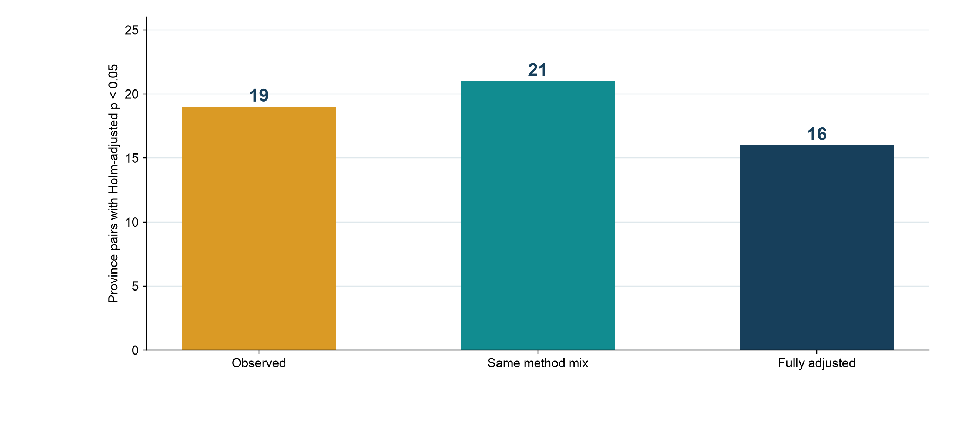
Regional comparisons depend on which differences are accounted for
Number of province pairs passing familywise Holm correction at 5%
Counts include sparse pairs and are descriptive of the testing stage; significance does not identify a cause of the gap.
29

Slide 30
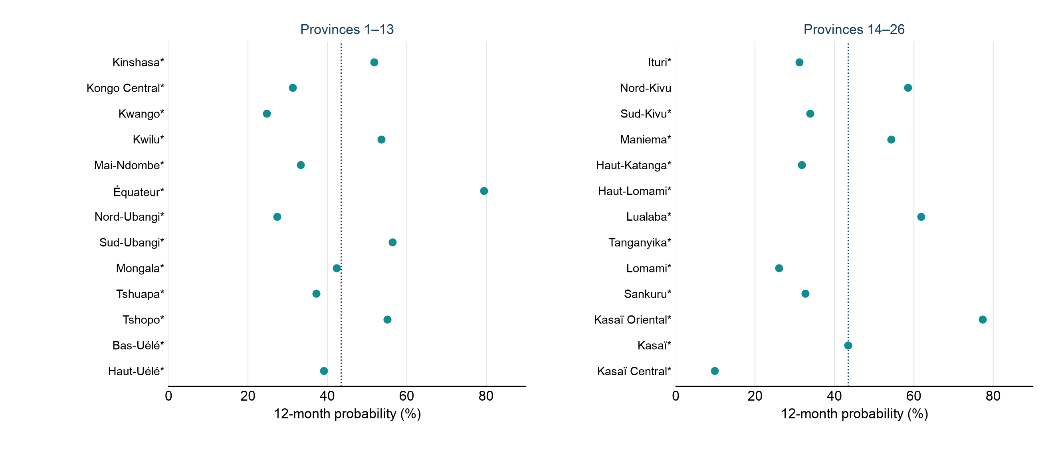
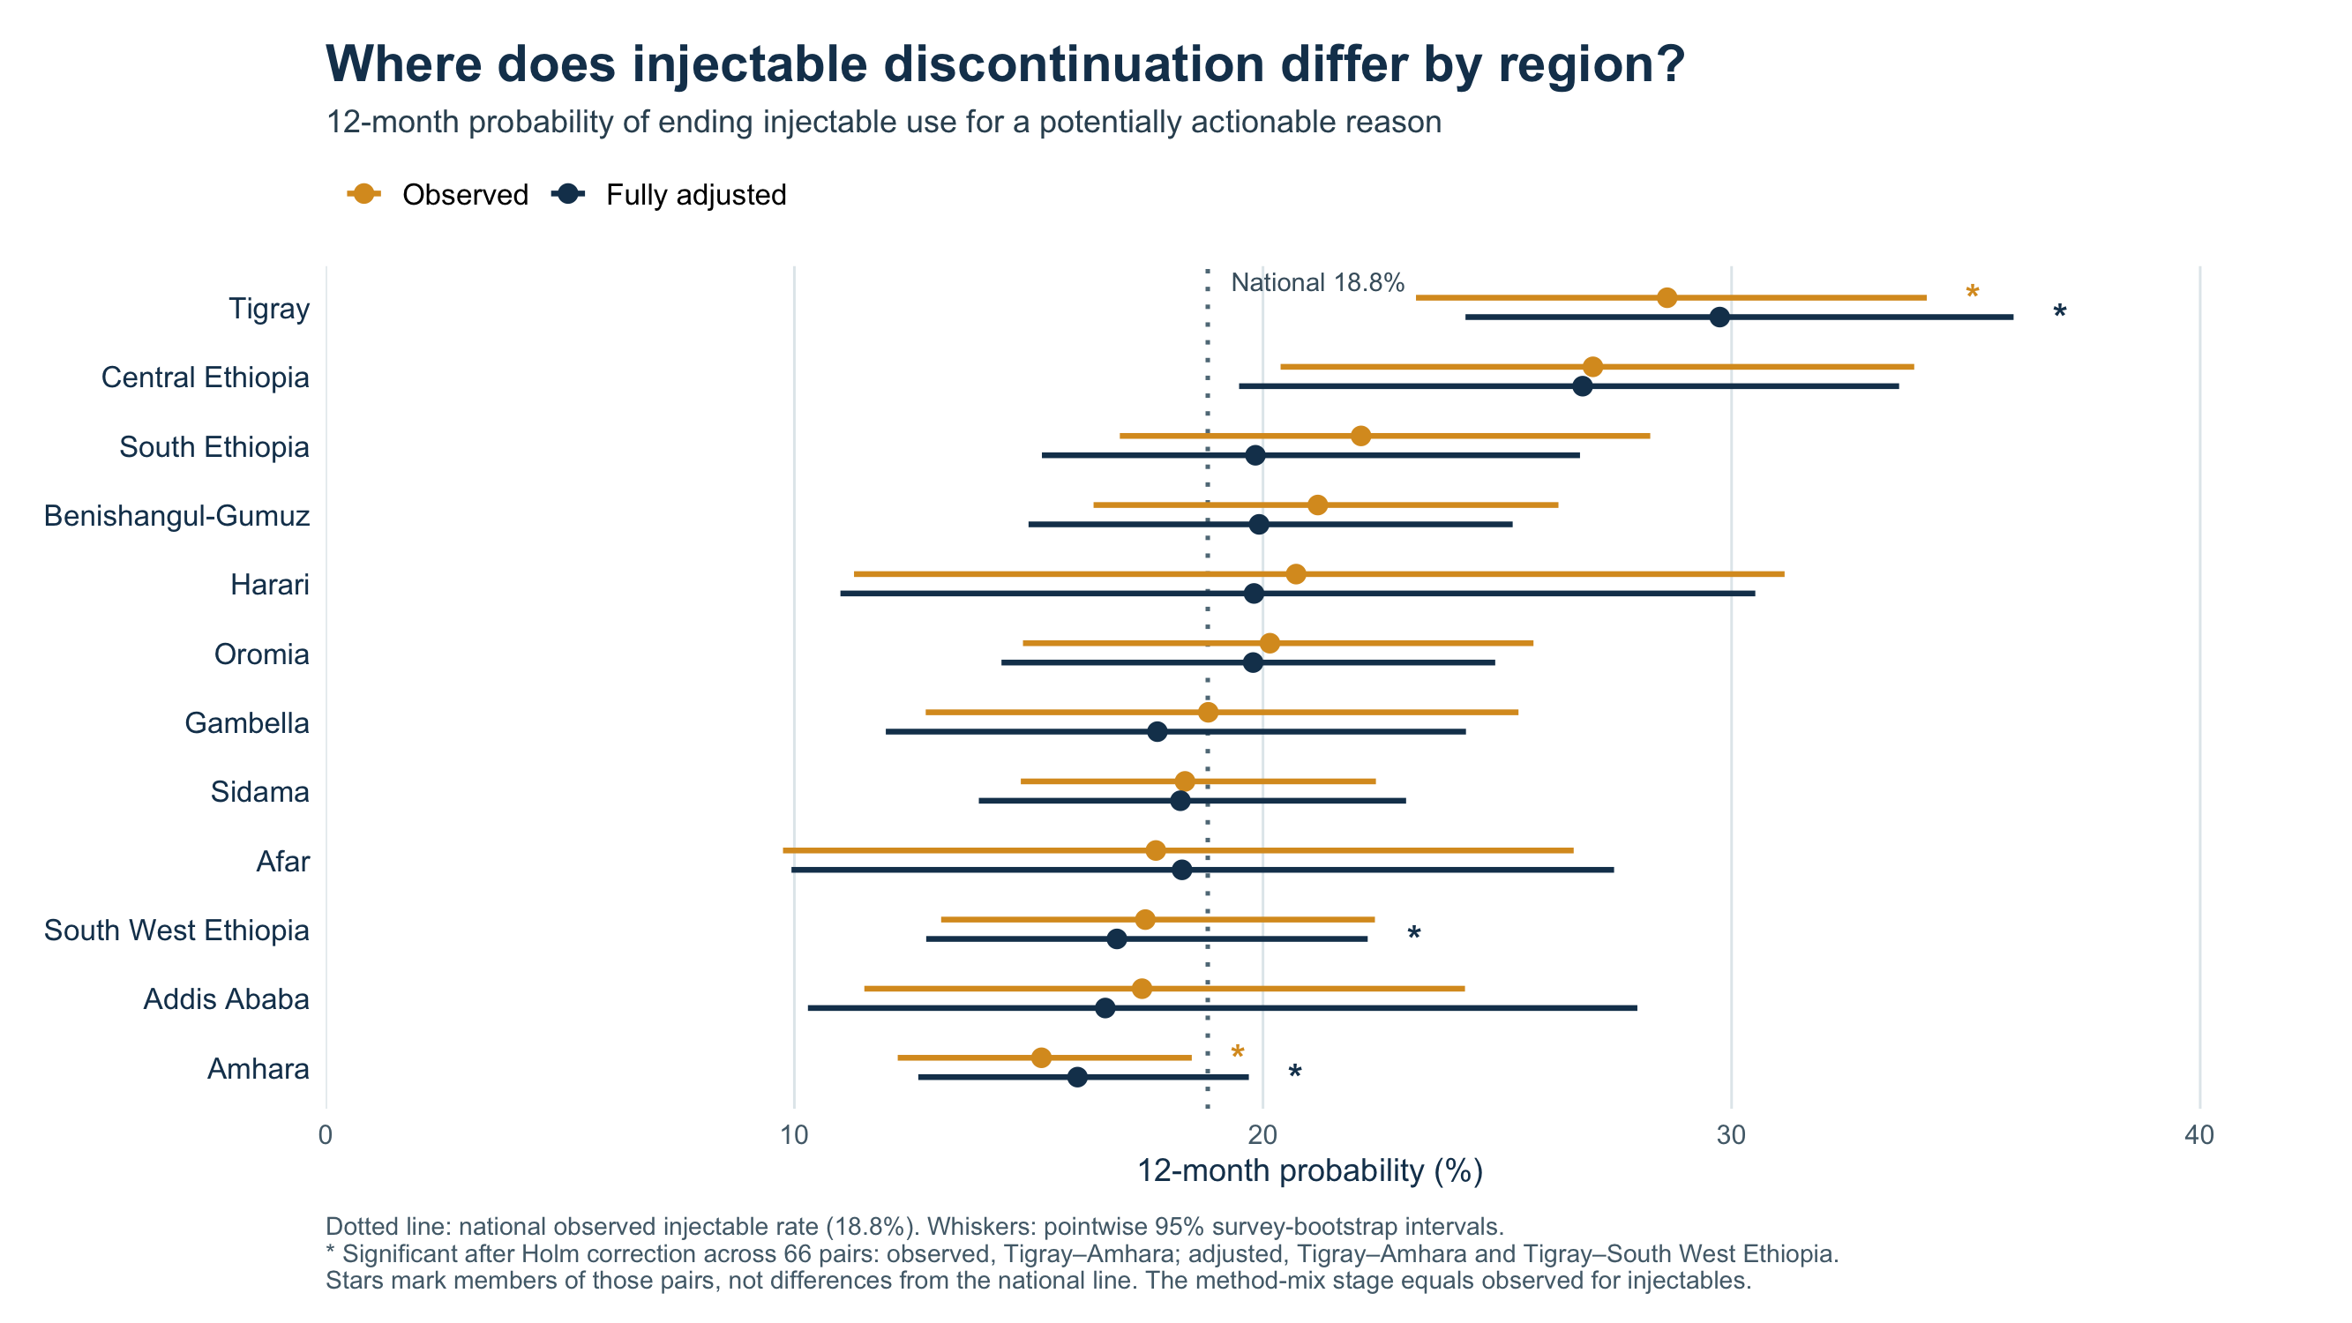
Injectable actionable discontinuation by province
Observed method-specific 12-month probabilities; dotted line is the national injectable rate
* Fewer than 30 actionable injectable endings. This sparse descriptive figure does not claim adjusted province differences.
30

Slide 31
Illustrative first-year actionable method endings
Projected 2025 current users: 2,598,898; 2026 women aged 15–49: 26,146,676
Method | Current mix | Current users | 12-month risk | Original-method endings
Injectables | 11.1% | 288,867 | 43.4% | 125,415
Implants | 23.7% | 616,035 | 16.0% | 98,632
Pill | 9.1% | 237,465 | 35.1% | 83,392
IUD | 0.4% | 11,528 | 21.1% | 2,431
Other modern | 45.2% | 1,175,502 | 16.6% | 194,814
Emergency contraception | 10.4% | 269,501 | — | —
All modern | 100.0% | 2,598,898 | 21.7% | 504,683
First-year risks are applied to current users without conditioning on prior duration. The total risk is current-user weighted, not the pooled episode life-table rate.
31

Slide 32
Current users ending each method for actionable reasons
Original-method endings from the first-year life table
Method | Current users | Method failure | Want more effective | Bleeding changes | Other health | Access / cost | All actionable
Injectables | 288,867 | 3,919 | 23,016 | 38,581 | 45,294 | 14,605 | 125,415
Implants | 616,035 | 430 | 4,023 | 28,159 | 60,351 | 5,669 | 98,632
Pill | 237,465 | 6,238 | 9,504 | 32,625 | 25,803 | 9,221 | 83,392
IUD | 11,528 | 0 | 0 | 0 | 2,431 | 0 | 2,431
Other modern | 1,175,502 | 22,734 | 99,684 | 24,528 | 14,562 | 33,307 | 194,814
All methods | 2,329,397 | 33,320 | 136,228 | 123,893 | 148,441 | 62,802 | 504,683
Each reason count is current users × its cause-specific competing-risk probability; causes sum to the method total.
32

Slide 33
2026 mCPR scenarios share the same DHS survey anchor
2024 survey mCPR: 9.9%; projected 2025 modern users: 2,598,898
Scenario | Projected 2025 mCPR | Change to 2026 | Illustrative 2026 mCPR
No further growth in 2026 | 10.3% | +0.0 pp | 10.3%
UN growth (+0.5 pp) | 10.3% | +0.5 pp | 10.8%
Track20 growth (+0.4 pp) | 10.3% | +0.4 pp | 10.7%
The 2024 DHS level is the anchor. A +0.4-point Track20 increment projects 2025; 2026 cases use 0, UN +0.5, or Track20 +0.4 points.
33

Slide 34
Illustrative mCPR equivalent if actionable method endings were avoided
Projected 2026 women aged 15–49: 26,146,676
Growth case | Usual 2026 users | Usual mCPR | Users if retained | mCPR if retained | Difference
No further growth in 2026 | 2,691,522 | 10.3% | 3,196,205 | 12.2% | 1.93 pp
UN growth (+0.5 pp) | 2,822,255 | 10.8% | 3,326,939 | 12.7% | 1.93 pp
Track20 growth (+0.4 pp) | 2,796,109 | 10.7% | 3,300,792 | 12.6% | 1.93 pp
Gross first-year original-method endings divided by projected 2026 women aged 15–49; switching and current duration are not incorporated.
34

Slide 35
No further growth in 2026: users and mCPR by method
First-year life-table approach; actionable original-method endings
Method | 2025 users | 2026 usual users | Endings counted | 2026 if retained | Usual mCPR | If retained
Injectables | 288,867 | 299,162 | 125,415 | 424,577 | 1.1% | 1.6%
Implants | 616,035 | 637,990 | 98,632 | 736,622 | 2.4% | 2.8%
Pill | 237,465 | 245,928 | 83,392 | 329,320 | 0.9% | 1.3%
IUD | 11,528 | 11,939 | 2,431 | 14,370 | 0.0% | 0.1%
Other modern | 1,175,502 | 1,217,396 | 194,814 | 1,412,210 | 4.7% | 5.4%
Emergency contraception | 269,501 | 279,106 | 0 | 279,106 | 1.1% | 1.1%
All modern | 2,598,898 | 2,691,522 | 504,683 | 3,196,205 | 10.3% | 12.2%
Method mCPR contribution is users divided by projected 2026 women aged 15–49. This is a gross accounting ceiling.
35

Slide 36
UN growth (+0.5 pp): users and mCPR by method
First-year life-table approach; actionable original-method endings
Method | 2025 users | 2026 usual users | Endings counted | 2026 if retained | Usual mCPR | If retained
Injectables | 288,867 | 313,693 | 125,415 | 439,108 | 1.2% | 1.7%
Implants | 616,035 | 668,979 | 98,632 | 767,611 | 2.6% | 2.9%
Pill | 237,465 | 257,874 | 83,392 | 341,265 | 1.0% | 1.3%
IUD | 11,528 | 12,519 | 2,431 | 14,950 | 0.0% | 0.1%
Other modern | 1,175,502 | 1,276,528 | 194,814 | 1,471,342 | 4.9% | 5.6%
Emergency contraception | 269,501 | 292,662 | 0 | 292,662 | 1.1% | 1.1%
All modern | 2,598,898 | 2,822,255 | 504,683 | 3,326,939 | 10.8% | 12.7%
Method mCPR contribution is users divided by projected 2026 women aged 15–49. This is a gross accounting ceiling.
36

Slide 37
Track20 growth (+0.4 pp): users and mCPR by method
First-year life-table approach; actionable original-method endings
Method | 2025 users | 2026 usual users | Endings counted | 2026 if retained | Usual mCPR | If retained
Injectables | 288,867 | 310,787 | 125,415 | 436,202 | 1.2% | 1.7%
Implants | 616,035 | 662,781 | 98,632 | 761,413 | 2.5% | 2.9%
Pill | 237,465 | 255,484 | 83,392 | 338,876 | 1.0% | 1.3%
IUD | 11,528 | 12,403 | 2,431 | 14,834 | 0.0% | 0.1%
Other modern | 1,175,502 | 1,264,702 | 194,814 | 1,459,516 | 4.8% | 5.6%
Emergency contraception | 269,501 | 289,951 | 0 | 289,951 | 1.1% | 1.1%
All modern | 2,598,898 | 2,796,109 | 504,683 | 3,300,792 | 10.7% | 12.6%
Method mCPR contribution is users divided by projected 2026 women aged 15–49. This is a gross accounting ceiling.
37

Slide 38
mCPR equivalent differs by actionable cause of method ending
First-year original-method endings, disaggregated by method and cause
Method | Method failure | Want more effective | Bleeding changes | Other health | Access / cost | All actionable
Injectables | 0.01 | 0.09 | 0.15 | 0.17 | 0.06 | 0.48
Implants | 0.00 | 0.02 | 0.11 | 0.23 | 0.02 | 0.38
Pill | 0.02 | 0.04 | 0.12 | 0.10 | 0.04 | 0.32
IUD | 0.00 | 0.00 | 0.00 | 0.01 | 0.00 | 0.01
Other modern | 0.09 | 0.38 | 0.09 | 0.06 | 0.13 | 0.75
All methods | 0.13 | 0.52 | 0.47 | 0.57 | 0.24 | 1.93
Each cell is projected original-method endings divided by 2026 women aged 15–49 × 100; values are percentage points.
38

Slide 39
Historical duration-aware: actionable endings and year-end nonmodern use
Projected current users; next 12 months conditional on time already used
Method | Current mix | Current users | Actionable ending risk | Nonmodern at year end
Injectables | 11.1% | 288,867 | 26.0% | 64,600
Implants | 23.7% | 616,035 | 10.7% | 58,866
Pill | 9.1% | 237,465 | 22.1% | 45,011
IUD | 0.4% | 11,528 | 10.9% | 1,107
Other modern | 45.2% | 1,175,502 | 12.1% | 124,097
Emergency contraception | 10.4% | 269,501 | — | —
All modern | 100.0% | 2,598,898 | 14.5% | 293,682
Ending probabilities condition on method and elapsed use; all-modern risk excludes EC. Switching enters only in year-end modern use.
39

Slide 40
Historical duration-aware: year-end nonmodern users by cause
Following a potentially actionable original-method ending
Method | Current users | Method failure | Want more effective | Bleeding changes | Other health | Access / cost | Nonmodern at year end
Injectables | 288,867 | 4,721 | 6,401 | 18,993 | 28,981 | 5,504 | 64,600
Implants | 616,035 | 1,285 | 767 | 24,114 | 31,793 | 907 | 58,866
Pill | 237,465 | 10,149 | 1,507 | 19,475 | 11,782 | 2,098 | 45,011
IUD | 11,528 | 0 | 74 | 0 | 66 | 967 | 1,107
Other modern | 1,175,502 | 44,329 | 39,241 | 12,798 | 6,667 | 21,062 | 124,097
All methods | 2,329,397 | 60,484 | 47,990 | 75,379 | 79,290 | 30,538 | 293,682
Method-by-cause counts sum to the number outside modern use at year end after an actionable ending.
40

Slide 41
Historical duration-aware: common 2026 mCPR baselines
Projected 2025 users: 2,598,898
Scenario | Projected 2025 mCPR | Change to 2026 | Illustrative 2026 mCPR
No further growth in 2026 | 10.3% | +0.0 pp | 10.3%
UN growth (+0.5 pp) | 10.3% | +0.5 pp | 10.8%
Track20 growth (+0.4 pp) | 10.3% | +0.4 pp | 10.7%
The same DHS-anchored growth assumptions are used across the three discontinuation-probability approaches.
41

Slide 42
Historical duration-aware: mCPR if year-end nonmodern loss were avoided
Projected 2026 women aged 15–49: 26,146,676
Growth case | Usual 2026 users | Usual mCPR | Users if retained | mCPR if retained | Difference
No further growth in 2026 | 2,691,522 | 10.3% | 2,985,204 | 11.4% | 1.12 pp
UN growth (+0.5 pp) | 2,822,255 | 10.8% | 3,115,937 | 11.9% | 1.12 pp
Track20 growth (+0.4 pp) | 2,796,109 | 10.7% | 3,089,790 | 11.8% | 1.12 pp
Year-end nonmodern users after actionable endings account for observed switching and restarting; divide by projected 2026 women aged 15–49.
42

Slide 43
Historical duration-aware: No further growth in 2026 by method
Usual modern users and illustrative retention of year-end nonmodern users
Method | 2025 users | 2026 usual users | Year-end loss counted | 2026 if retained | Usual mCPR | If retained
Injectables | 288,867 | 299,162 | 64,600 | 363,763 | 1.1% | 1.4%
Implants | 616,035 | 637,990 | 58,866 | 696,856 | 2.4% | 2.7%
Pill | 237,465 | 245,928 | 45,011 | 290,940 | 0.9% | 1.1%
IUD | 11,528 | 11,939 | 1,107 | 13,046 | 0.0% | 0.0%
Other modern | 1,175,502 | 1,217,396 | 124,097 | 1,341,494 | 4.7% | 5.1%
Emergency contraception | 269,501 | 279,106 | 0 | 279,106 | 1.1% | 1.1%
All modern | 2,598,898 | 2,691,522 | 293,682 | 2,985,204 | 10.3% | 11.4%
Ending probabilities condition on time already used; observed switching and restarting adjust the mCPR illustration.
43

Slide 44
Historical duration-aware: UN growth (+0.5 pp) by method
Usual modern users and illustrative retention of year-end nonmodern users
Method | 2025 users | 2026 usual users | Year-end loss counted | 2026 if retained | Usual mCPR | If retained
Injectables | 288,867 | 313,693 | 64,600 | 378,294 | 1.2% | 1.4%
Implants | 616,035 | 668,979 | 58,866 | 727,845 | 2.6% | 2.8%
Pill | 237,465 | 257,874 | 45,011 | 302,885 | 1.0% | 1.2%
IUD | 11,528 | 12,519 | 1,107 | 13,626 | 0.0% | 0.1%
Other modern | 1,175,502 | 1,276,528 | 124,097 | 1,400,625 | 4.9% | 5.4%
Emergency contraception | 269,501 | 292,662 | 0 | 292,662 | 1.1% | 1.1%
All modern | 2,598,898 | 2,822,255 | 293,682 | 3,115,937 | 10.8% | 11.9%
Ending probabilities condition on time already used; observed switching and restarting adjust the mCPR illustration.
44

Slide 45
Historical duration-aware: Track20 growth (+0.4 pp) by method
Usual modern users and illustrative retention of year-end nonmodern users
Method | 2025 users | 2026 usual users | Year-end loss counted | 2026 if retained | Usual mCPR | If retained
Injectables | 288,867 | 310,787 | 64,600 | 375,388 | 1.2% | 1.4%
Implants | 616,035 | 662,781 | 58,866 | 721,647 | 2.5% | 2.8%
Pill | 237,465 | 255,484 | 45,011 | 300,496 | 1.0% | 1.1%
IUD | 11,528 | 12,403 | 1,107 | 13,510 | 0.0% | 0.1%
Other modern | 1,175,502 | 1,264,702 | 124,097 | 1,388,799 | 4.8% | 5.3%
Emergency contraception | 269,501 | 289,951 | 0 | 289,951 | 1.1% | 1.1%
All modern | 2,598,898 | 2,796,109 | 293,682 | 3,089,790 | 10.7% | 11.8%
Ending probabilities condition on time already used; observed switching and restarting adjust the mCPR illustration.
45

Slide 46
Historical duration-aware: mCPR equivalent by actionable cause
Year-end nonmodern users after actionable original-method endings
Method | Method failure | Want more effective | Bleeding changes | Other health | Access / cost | All actionable
Injectables | 0.02 | 0.02 | 0.07 | 0.11 | 0.02 | 0.25
Implants | 0.00 | 0.00 | 0.09 | 0.12 | 0.00 | 0.23
Pill | 0.04 | 0.01 | 0.07 | 0.05 | 0.01 | 0.17
IUD | 0.00 | 0.00 | 0.00 | 0.00 | 0.00 | 0.00
Other modern | 0.17 | 0.15 | 0.05 | 0.03 | 0.08 | 0.47
All methods | 0.23 | 0.18 | 0.29 | 0.30 | 0.12 | 1.12
Each cell uses the year-end nonmodern count after observed switching and restarting, divided by 2026 women aged 15–49 × 100.
46

Slide 47
AFT survival + pathways: actionable endings and year-end nonmodern use
Projected current users; next 12 months conditional on time already used
Method | Current mix | Current users | Actionable ending risk | Nonmodern at year end
Injectables | 11.1% | 288,867 | 27.6% | 68,098
Implants | 23.7% | 616,035 | 10.9% | 59,493
Pill | 9.1% | 237,465 | 23.7% | 46,913
IUD | 0.4% | 11,528 | 11.3% | 456
Other modern | 45.2% | 1,175,502 | 12.1% | 123,398
Emergency contraception | 10.4% | 269,501 | — | —
All modern | 100.0% | 2,598,898 | 14.9% | 298,359
Conditional probabilities reflect method and elapsed use; year-end status incorporates observed switching and restarting pathways.
47

Slide 48
AFT survival + pathways: year-end nonmodern users by cause
Following a potentially actionable original-method ending
Method | Current users | Method failure | Want more effective | Bleeding changes | Other health | Access / cost | Nonmodern at year end
Injectables | 288,867 | 5,733 | 8,360 | 21,222 | 25,663 | 7,120 | 68,098
Implants | 616,035 | 452 | 1,201 | 16,698 | 37,792 | 3,350 | 59,493
Pill | 237,465 | 7,222 | 5,513 | 16,286 | 13,606 | 4,286 | 46,913
IUD | 11,528 | 0 | 192 | 0 | 110 | 154 | 456
Other modern | 1,175,502 | 30,534 | 41,275 | 15,230 | 18,729 | 17,631 | 123,398
All methods | 2,329,397 | 43,941 | 56,541 | 69,436 | 95,899 | 32,542 | 298,359
Method-by-cause counts sum to the number outside modern use at year end after an actionable ending.
48

Slide 49
AFT survival + pathways: common 2026 mCPR baselines
Projected 2025 users: 2,598,898
Scenario | Projected 2025 mCPR | Change to 2026 | Illustrative 2026 mCPR
No further growth in 2026 | 10.3% | +0.0 pp | 10.3%
UN growth (+0.5 pp) | 10.3% | +0.5 pp | 10.8%
Track20 growth (+0.4 pp) | 10.3% | +0.4 pp | 10.7%
The same DHS-anchored growth assumptions are used across the three discontinuation-probability approaches.
49

Slide 50
AFT survival + pathways: mCPR if year-end nonmodern loss were avoided
Projected 2026 women aged 15–49: 26,146,676
Growth case | Usual 2026 users | Usual mCPR | Users if retained | mCPR if retained | Difference
No further growth in 2026 | 2,691,522 | 10.3% | 2,989,881 | 11.4% | 1.14 pp
UN growth (+0.5 pp) | 2,822,255 | 10.8% | 3,120,614 | 11.9% | 1.14 pp
Track20 growth (+0.4 pp) | 2,796,109 | 10.7% | 3,094,468 | 11.8% | 1.14 pp
Year-end nonmodern users after actionable original-method endings divided by projected 2026 women aged 15–49.
50

Slide 51
AFT survival + pathways: No further growth in 2026 by method
Usual modern users and illustrative retention of year-end nonmodern users
Method | 2025 users | 2026 usual users | Year-end loss counted | 2026 if retained | Usual mCPR | If retained
Injectables | 288,867 | 299,162 | 68,098 | 367,261 | 1.1% | 1.4%
Implants | 616,035 | 637,990 | 59,493 | 697,483 | 2.4% | 2.7%
Pill | 237,465 | 245,928 | 46,913 | 292,841 | 0.9% | 1.1%
IUD | 11,528 | 11,939 | 456 | 12,395 | 0.0% | 0.0%
Other modern | 1,175,502 | 1,217,396 | 123,398 | 1,340,795 | 4.7% | 5.1%
Emergency contraception | 269,501 | 279,106 | 0 | 279,106 | 1.1% | 1.1%
All modern | 2,598,898 | 2,691,522 | 298,359 | 2,989,881 | 10.3% | 11.4%
Conditional risk uses time already on the current method. Observed pathways inform year-end modern-use status.
51

Slide 52
AFT survival + pathways: UN growth (+0.5 pp) by method
Usual modern users and illustrative retention of year-end nonmodern users
Method | 2025 users | 2026 usual users | Year-end loss counted | 2026 if retained | Usual mCPR | If retained
Injectables | 288,867 | 313,693 | 68,098 | 381,792 | 1.2% | 1.5%
Implants | 616,035 | 668,979 | 59,493 | 728,472 | 2.6% | 2.8%
Pill | 237,465 | 257,874 | 46,913 | 304,787 | 1.0% | 1.2%
IUD | 11,528 | 12,519 | 456 | 12,975 | 0.0% | 0.0%
Other modern | 1,175,502 | 1,276,528 | 123,398 | 1,399,926 | 4.9% | 5.4%
Emergency contraception | 269,501 | 292,662 | 0 | 292,662 | 1.1% | 1.1%
All modern | 2,598,898 | 2,822,255 | 298,359 | 3,120,614 | 10.8% | 11.9%
Conditional risk uses time already on the current method. Observed pathways inform year-end modern-use status.
52

Slide 53
AFT survival + pathways: Track20 growth (+0.4 pp) by method
Usual modern users and illustrative retention of year-end nonmodern users
Method | 2025 users | 2026 usual users | Year-end loss counted | 2026 if retained | Usual mCPR | If retained
Injectables | 288,867 | 310,787 | 68,098 | 378,886 | 1.2% | 1.4%
Implants | 616,035 | 662,781 | 59,493 | 722,274 | 2.5% | 2.8%
Pill | 237,465 | 255,484 | 46,913 | 302,398 | 1.0% | 1.2%
IUD | 11,528 | 12,403 | 456 | 12,859 | 0.0% | 0.0%
Other modern | 1,175,502 | 1,264,702 | 123,398 | 1,388,100 | 4.8% | 5.3%
Emergency contraception | 269,501 | 289,951 | 0 | 289,951 | 1.1% | 1.1%
All modern | 2,598,898 | 2,796,109 | 298,359 | 3,094,468 | 10.7% | 11.8%
Conditional risk uses time already on the current method. Observed pathways inform year-end modern-use status.
53

Slide 54
AFT survival + pathways: mCPR equivalent by actionable cause
Year-end nonmodern users after actionable original-method endings
Method | Method failure | Want more effective | Bleeding changes | Other health | Access / cost | All actionable
Injectables | 0.02 | 0.03 | 0.08 | 0.10 | 0.03 | 0.26
Implants | 0.00 | 0.00 | 0.06 | 0.14 | 0.01 | 0.23
Pill | 0.03 | 0.02 | 0.06 | 0.05 | 0.02 | 0.18
IUD | 0.00 | 0.00 | 0.00 | 0.00 | 0.00 | 0.00
Other modern | 0.12 | 0.16 | 0.06 | 0.07 | 0.07 | 0.47
All methods | 0.17 | 0.22 | 0.27 | 0.37 | 0.12 | 1.14
Each cell is the year-end nonmodern count divided by projected 2026 women aged 15–49 × 100 (percentage points).
54

